Slide 1
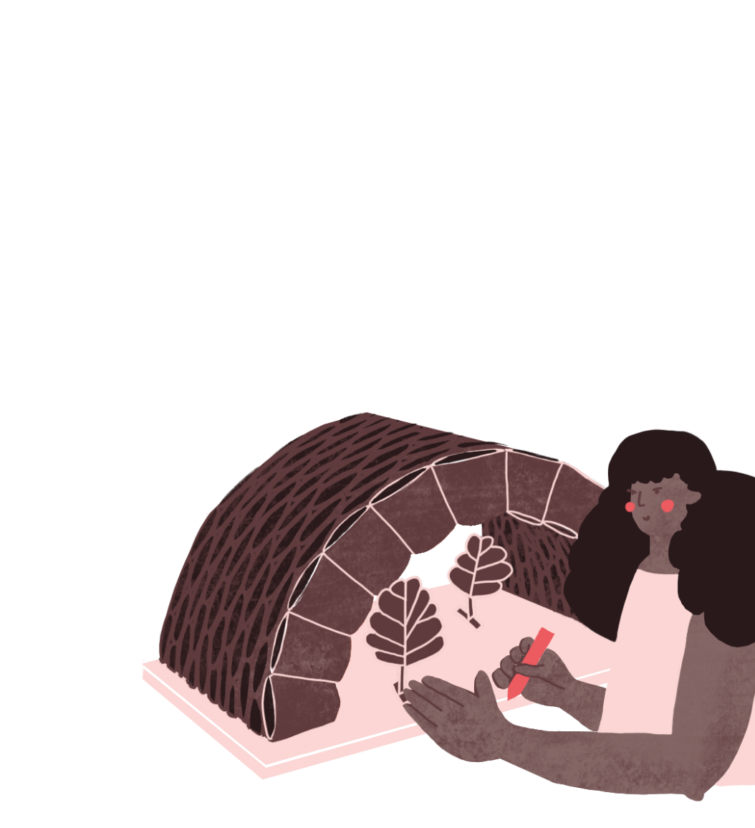

Botanical Gardens
^{‘LET’S DO SOME MATHS!’}
KS2 | Learning Points
Architecture | Learning Points
Recycling
Experimentation
Materials
Form
Measurement
Energy
Environment
Scales
Measurement
Formulae
Shapes
Volume
Surfaces
Algebra
^{RIBA}
^{Learning_Mathematics Activity}

Slide 2
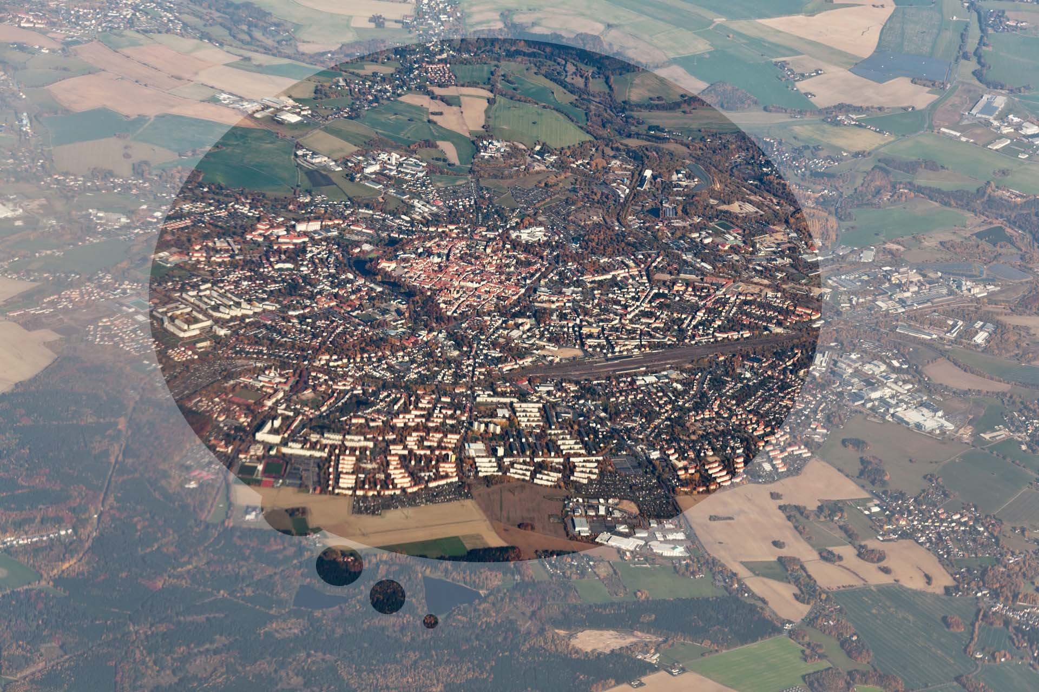
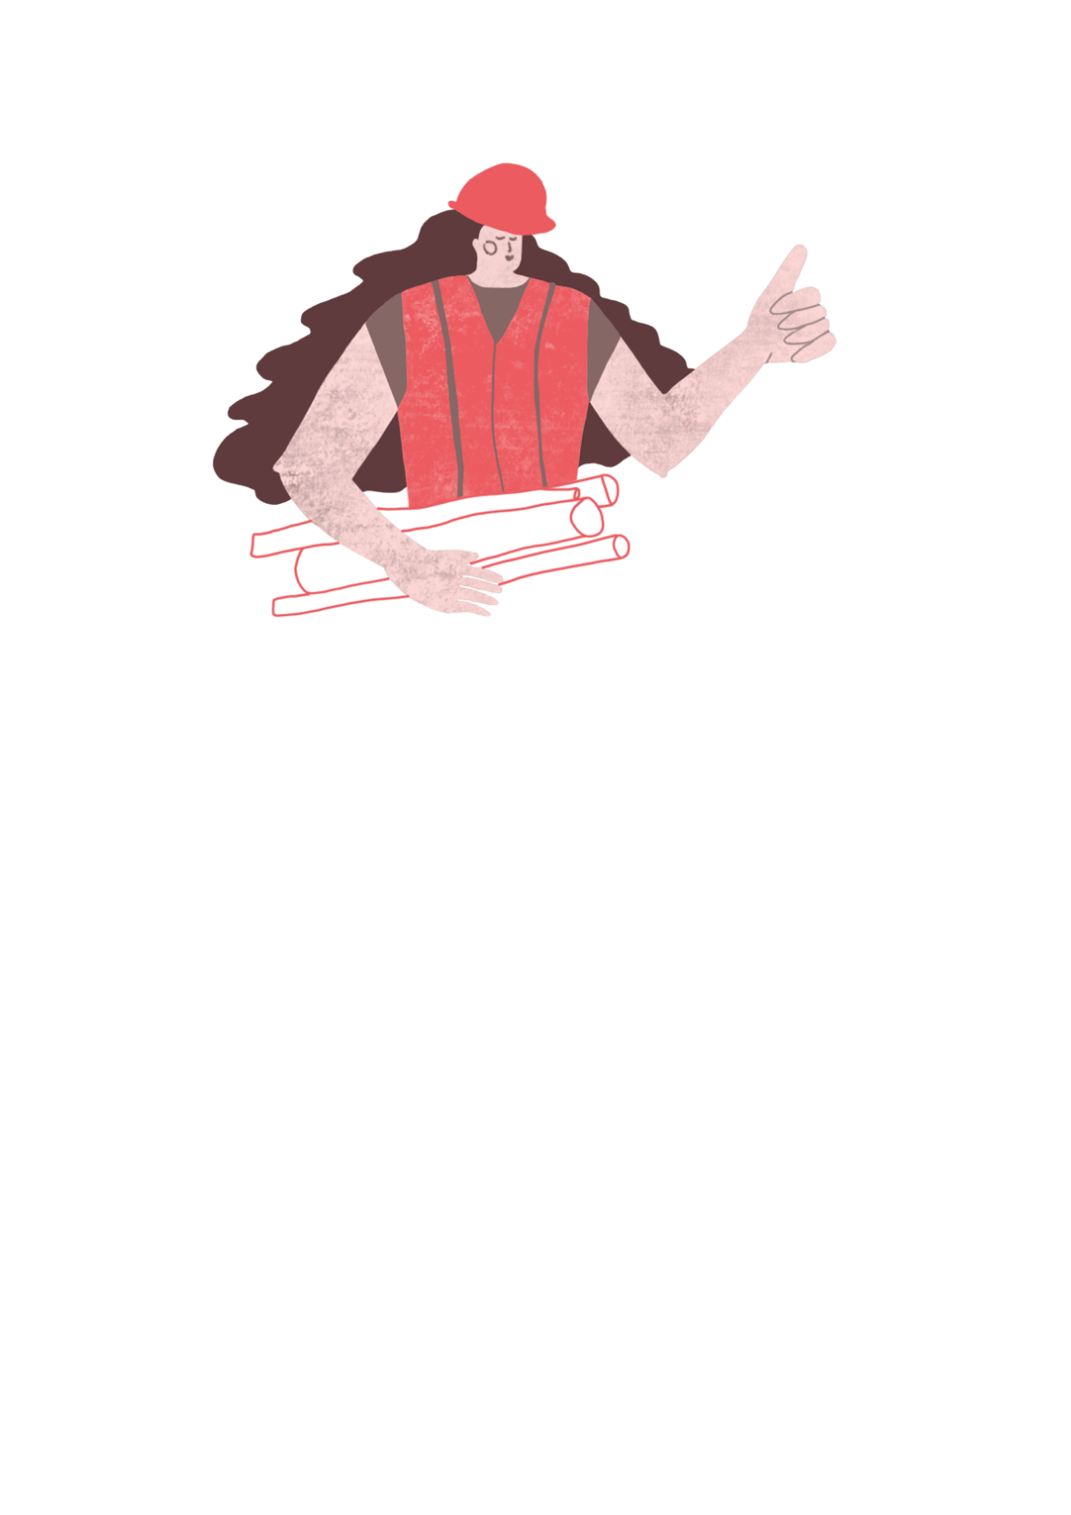
Architects design the buildings and places where we live, work and love to visit.
^{RIBA}
^{Learning_Mathematics Activity}

Slide 3
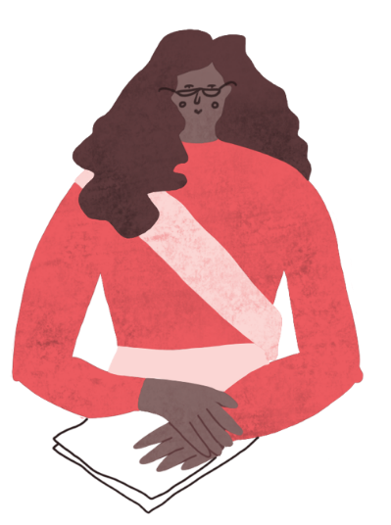

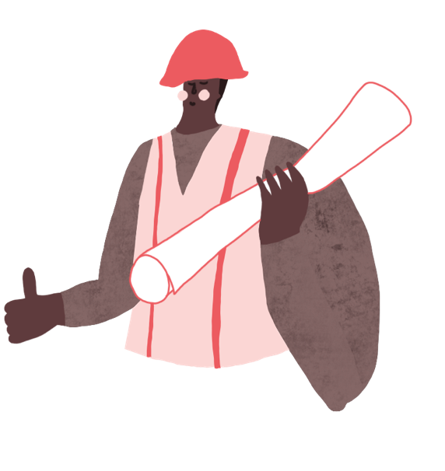
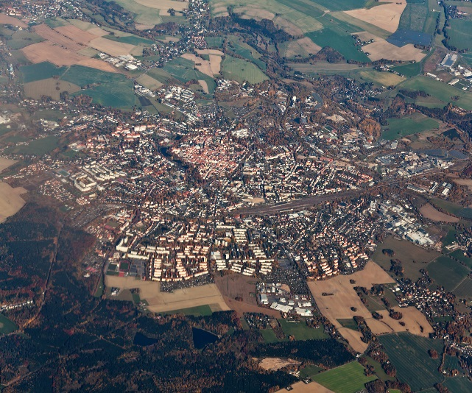
“Sophie and Tomas are architects who live in the City of Towncaster, where they work with the community, their friends and the Mayor of Greater Towncaster.”
^{Sophie}
^{Tomas}
^{RIBA}
^{Learning_Mathematics Activity}
^{Towncaster}

Slide 4
Sophie and Tomas enjoy creating places which you can enjoy too!
^{Sophie}
^{Tomas}
^{RIBA}
^{Learning_Mathematics Activity}
^{Towncaster}

Slide 5
“ Architects need to know about lots of different things such as peoples’ needs, how to make things and how much things will cost.”
^{Sophie}
^{Tomas}
^{RIBA}
^{Learning_Mathematics Activity}
^{Towncaster}

Slide 6
“ Architects need to know about lots of different things such as peoples’ needs, how to make things and how much things will cost.”
“On the exciting architecture projects we’re designing for Towncaster, we need to use mathematics to help work things out and would like you to help us with our sums.”
^{Sophie}
^{Tomas}
^{RIBA}
^{Learning_Mathematics Activity}
^{Towncaster}

Slide 7
Architects Sophie and Tomas have been asked by the Mayor of Towncaster to design a new Botanical Gardens for the city market which can provide:
_A big space for growing bushes and trees
_Lots of natural light for the plants
_As environment design
_A beautiful design to attract visitors
_A great day out for pupils learning about the environment
^{RIBA}
^{Learning_Mathematics Activity}

Slide 8
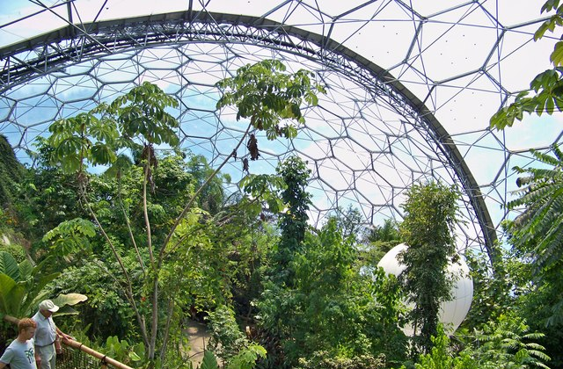
“Looking after our planet is so important for everyone including the people of Towncaster…
We need an excellent centre of learning so we can make our contribution. I’ll ask Sophie and Tomas what they think.”
Image: James T M Towill (A rainforest at the eden project) (2017)(geograph.co.uk)
^{RIBA}
^{Learning_Mathematics Activity}

Slide 9
“Towncaster, is a beautiful city. If it had a botanical gardens we could learn about beautiful environments from all around the world and how important they are.”
Image: James T M Towill (A rainforest at the eden project) (2017)(geograph.co.uk)
^{RIBA}
^{Learning_Mathematics Activity}

Slide 10
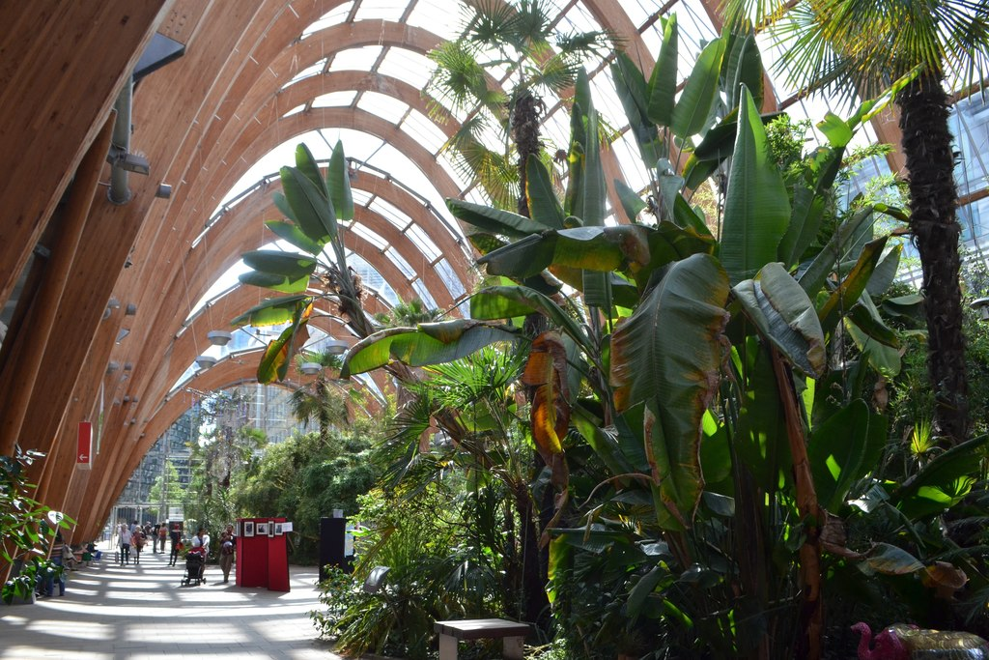
“Because the climates in different parts of the world are so different to each other, we will need a special type of building design to house exotic plants.
Let’s be honest, Towncaster can be a bit wet, windy during most of the year and a quite a bit chilly in winter.”
Image: Andrew Tryon; Sheffield Winter Gardens (geogrpah.org.uk)
^{RIBA}
^{Learning_Mathematics Activity}

Slide 11
“We’ll need to design a giant green house which lets in the suns light but keeps in the heat.”
Image: Andrew Tryon; Sheffield Winter Gardens (geogrpah.org.uk)
^{RIBA}
^{Learning_Mathematics Activity}

Slide 12
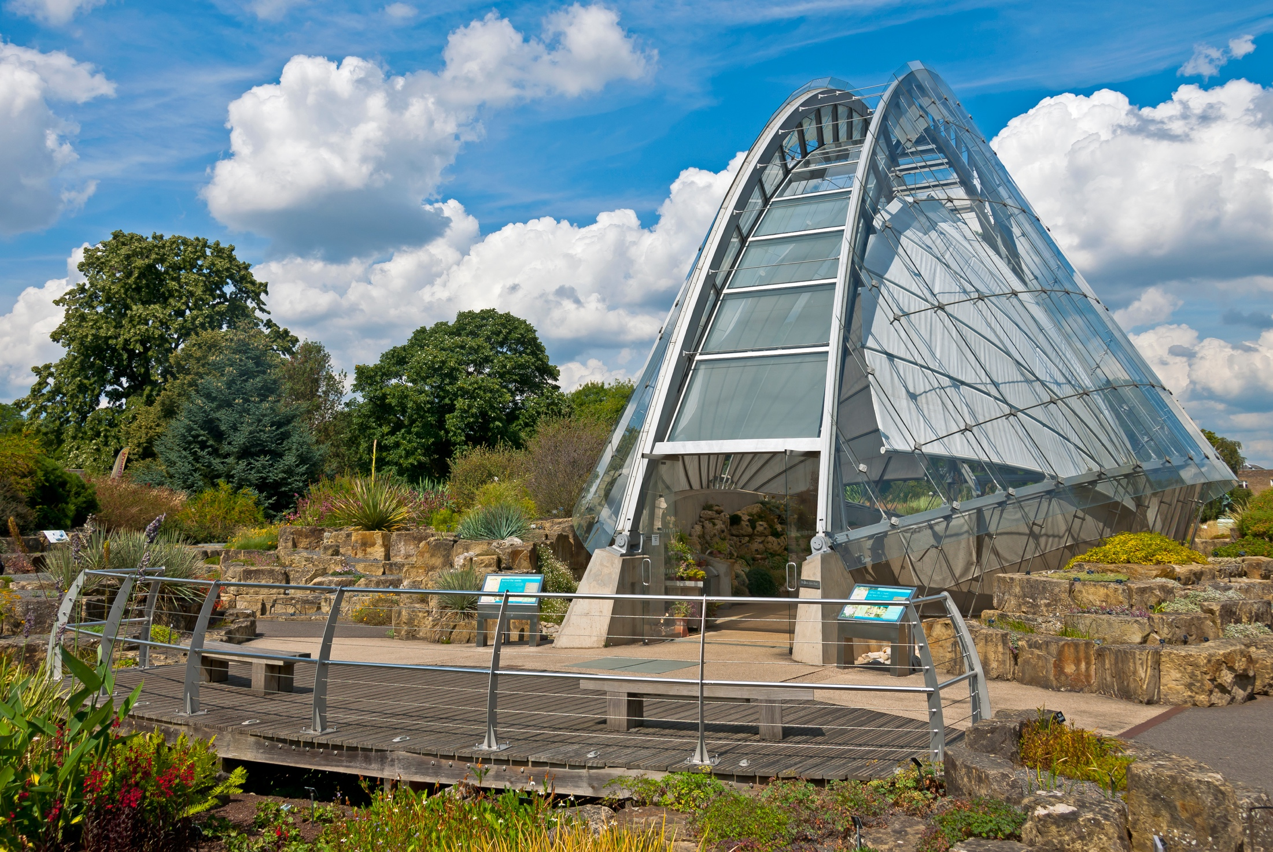
“Wow! A new Botanical Gardens for Towncaster, what a brilliant idea.
Make sure it is a sound environmental design which minimises energy and uses recycled materials.”
Image: Daniel Case: Alpine House at Kew Gardens (2014)(wikipedia.org)
^{RIBA}
^{Learning_Mathematics Activity}

Slide 13
“We can work out what we need by building a model to test out our ideas. Architects like Sophie and I do this all the time.”
Image: Daniel Case: Alpine House at Kew Gardens (2014)(wikipedia.org)
^{RIBA}
^{Learning_Mathematics Activity}

Slide 14
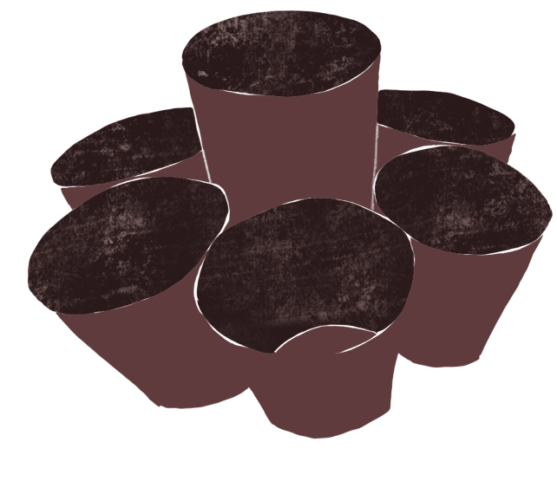
^{Sophie}
In architecture we like to experiment with different materials. For this project we’ve asked you to collect as many plastic drinking cups as you can.
^{Tomas}
^{RIBA}
^{Learning_Mathematics Activity}

Slide 15
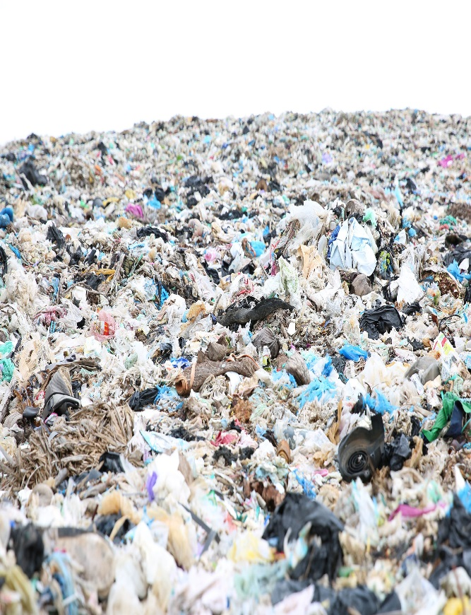
“But isn’t disposable plastic one of the worst sources of pollution in the environment?”
^{Sophie}
^{Tomas}
^{RIBA}
^{Learning_Mathematics Activity}

Slide 16
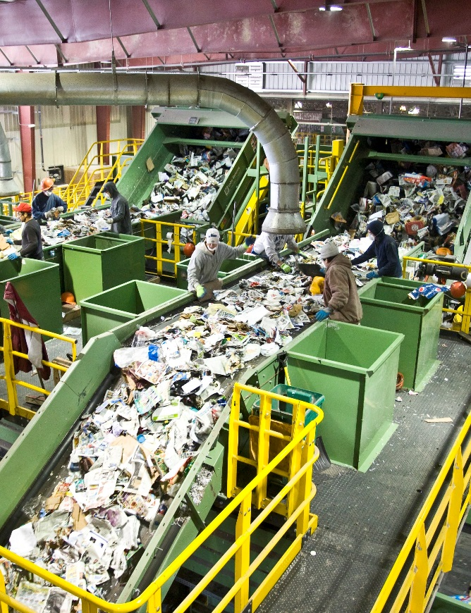
“Absolutely right, which is why we are going make experimental designs by recycling used plastic drinking cups.
Make sure you’ve washed them first.”
“But isn’t disposable plastic one of the worst sources of pollution in the environment?”
^{Sophie}
^{Tomas}
^{RIBA}
^{Learning_Mathematics Activity}

Slide 17
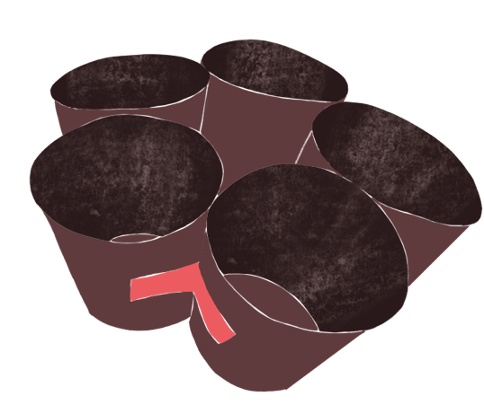
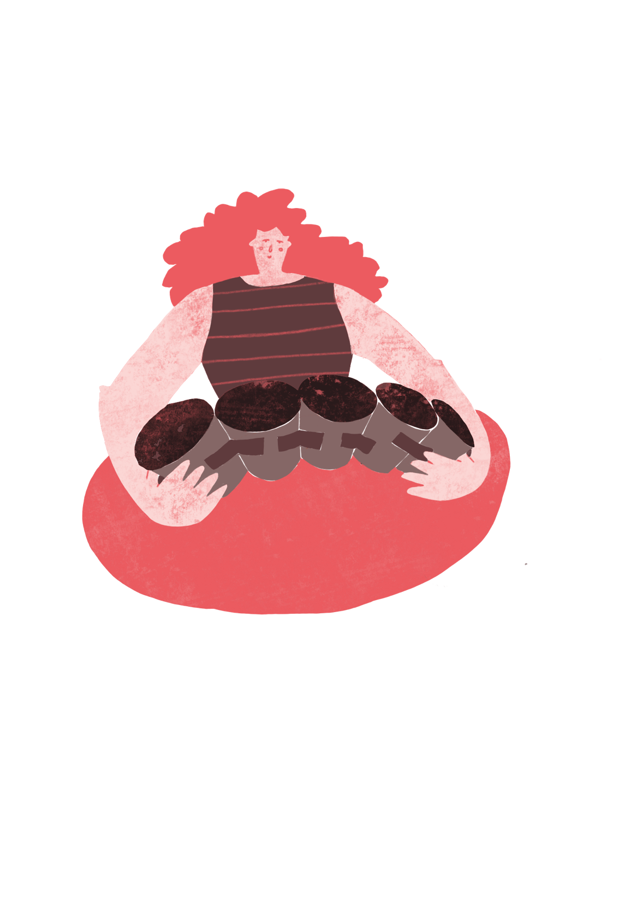
“We can use paper clips, stick tape and other methods to connect the plastic cups together.”
^{RIBA}
^{Learning_Mathematics Activity}

Slide 18
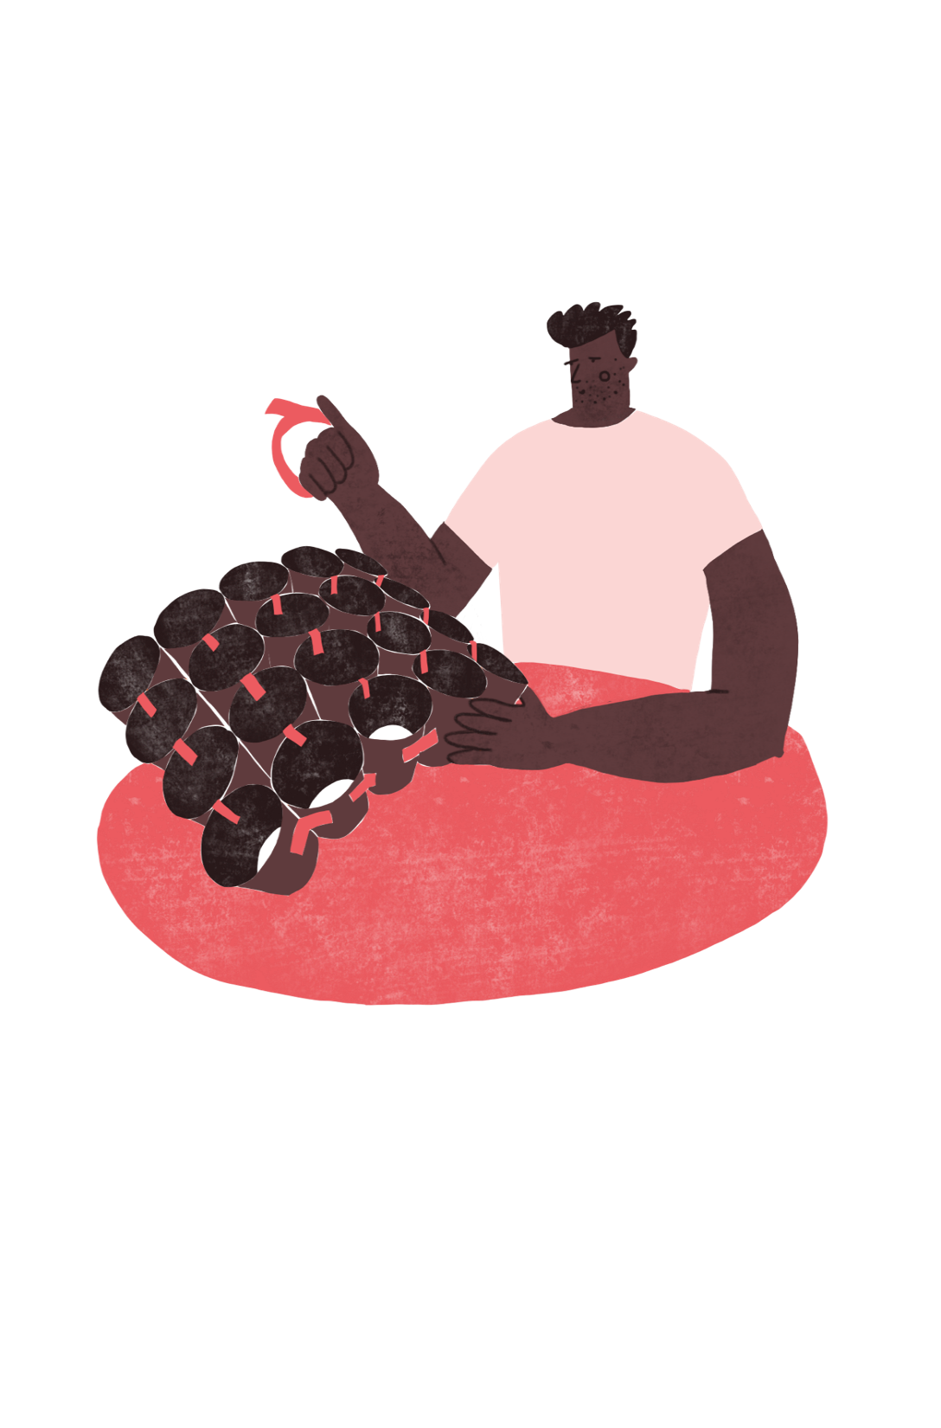
“If we connect enough together we can make a big curved surface.”
^{RIBA}
^{Learning_Mathematics Activity}

Slide 19
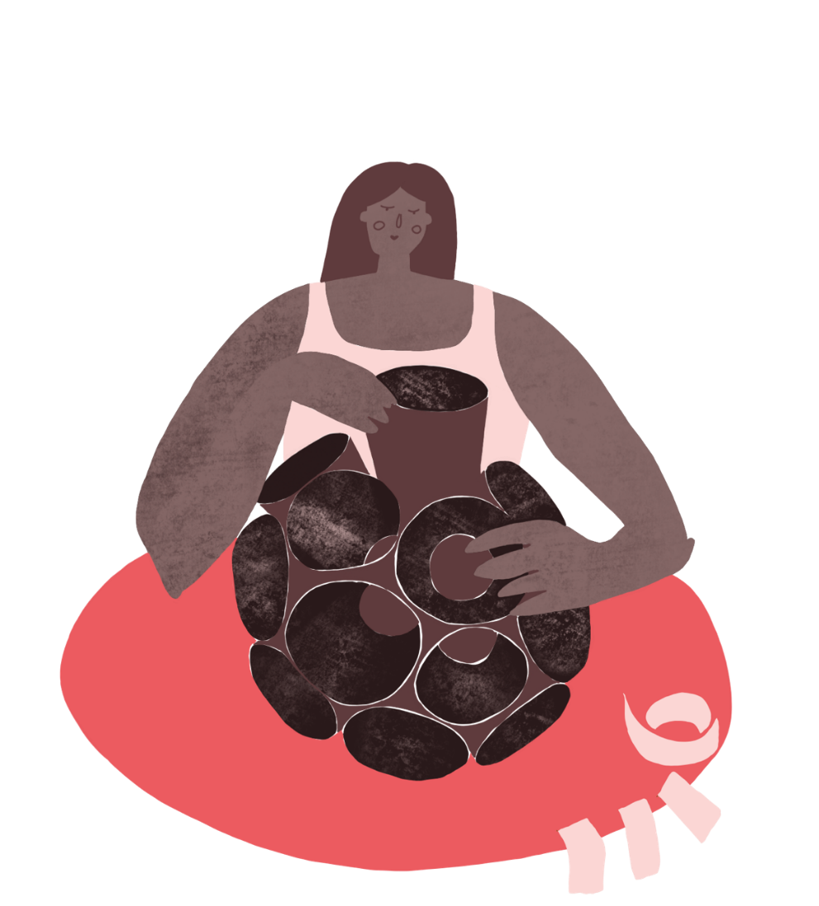
“And by connecting the cups together in different ways we can make different curved surfaces.”
^{RIBA}
^{Learning_Mathematics Activity}

Slide 20
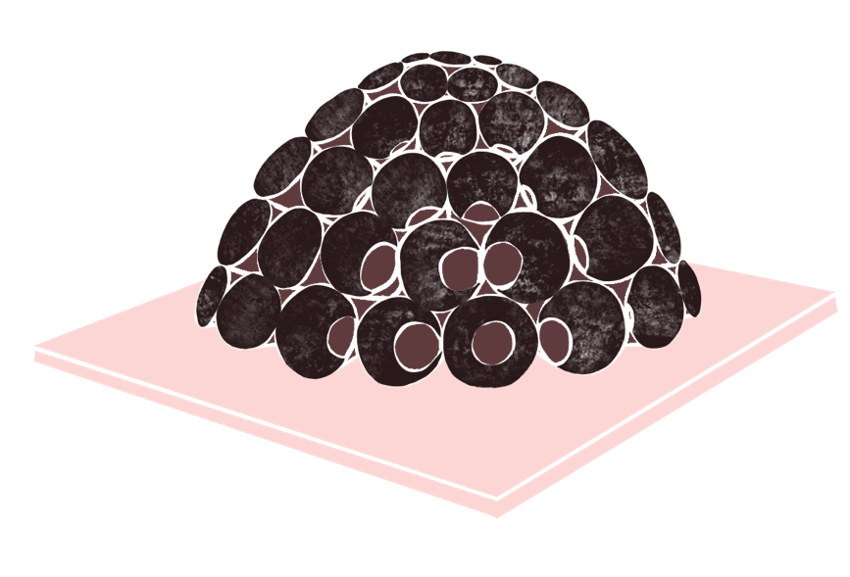
“By making hexagons and pentagons we can make a football or a dome!”
^{RIBA}
^{Learning_Mathematics Activity}

Slide 21
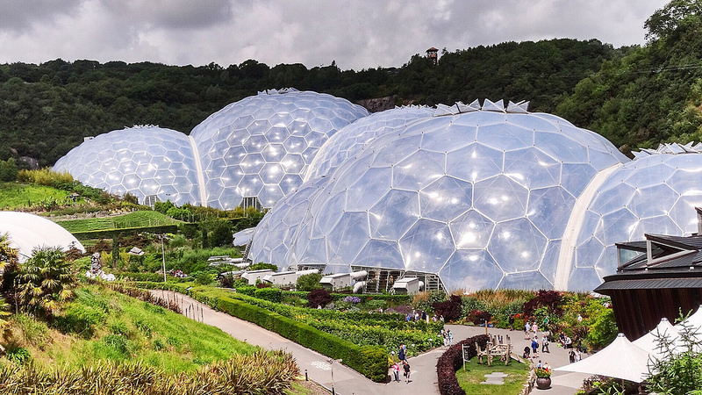
“Like this one”
Image: Simon Gidley., 2015: Eden Project, (flikr.com)
^{RIBA}
^{Learning_Mathematics Activity}

Slide 22
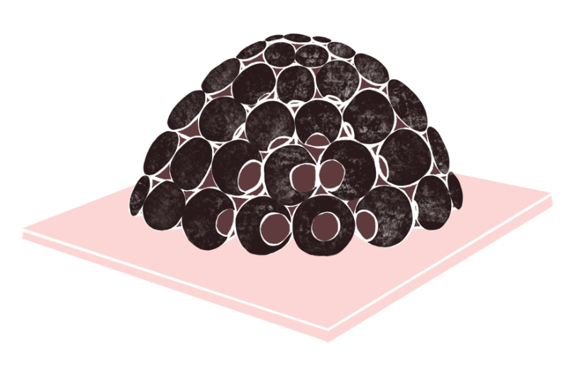
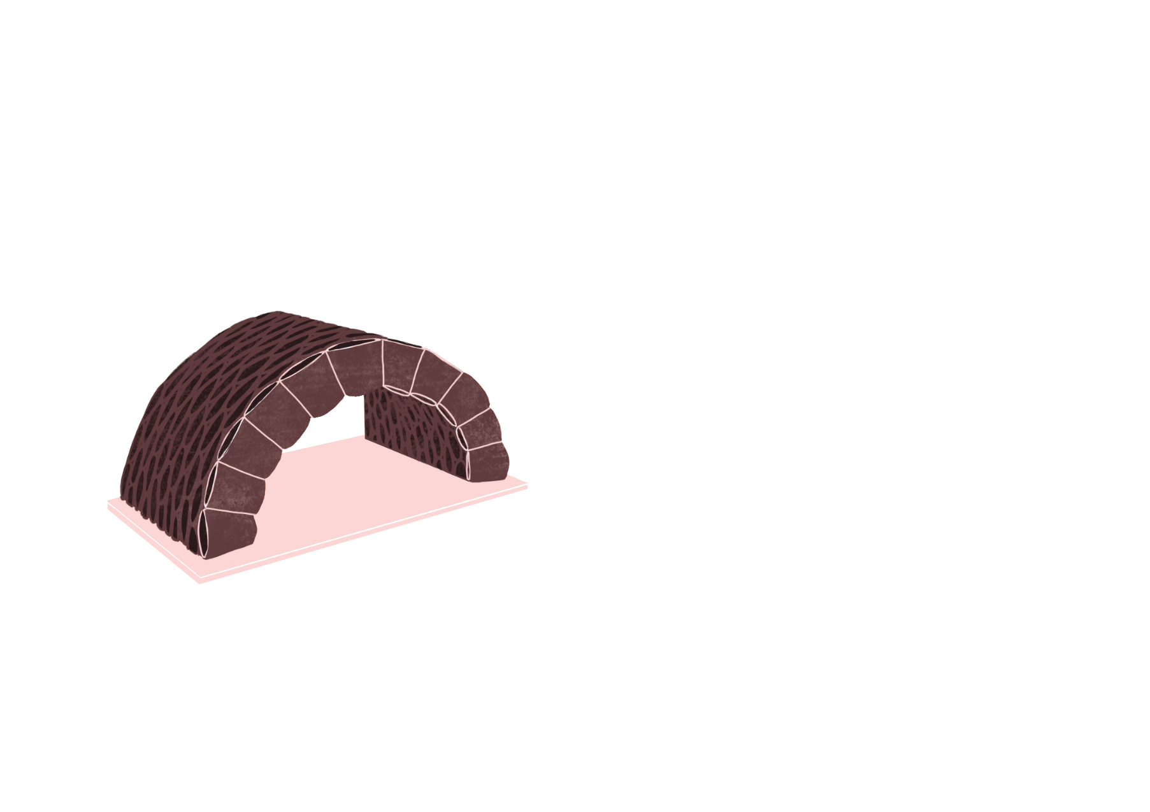
“If you fix your experimental surface to a board to represent the ground you can see how we could make a greenhouse building from recycled materials.
But which shape is more energy efficient?”
^{RIBA}
^{Learning_Mathematics Activity}

Slide 23
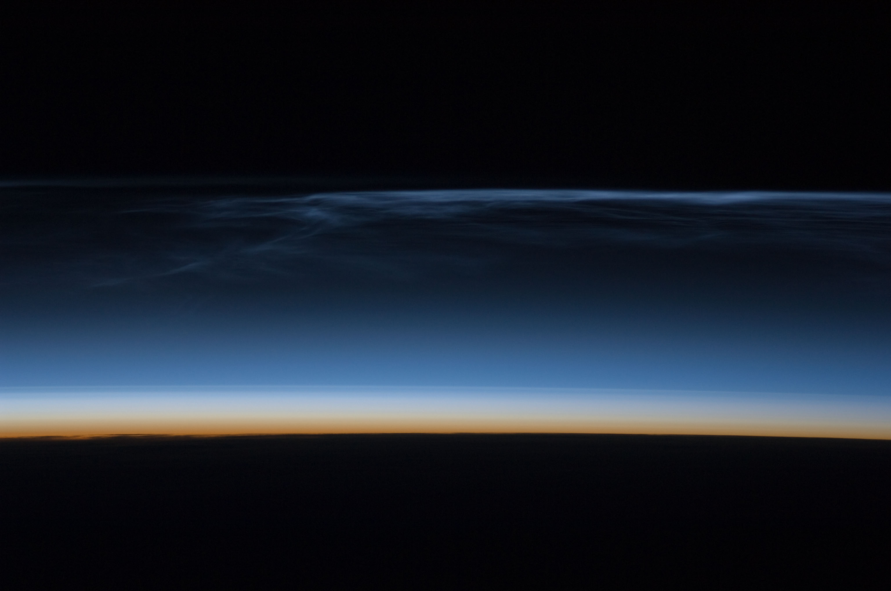
“The atmosphere of the Earth works like a giant green house keeping us warm.
But a gas called carbon dioxide or CO2 in our atmosphere is making the world too warm.
This is called Global Warming.”
Image: Noctilucent_clouds_over_Asia
^{RIBA}
^{Learning_Mathematics Activity}

Slide 24
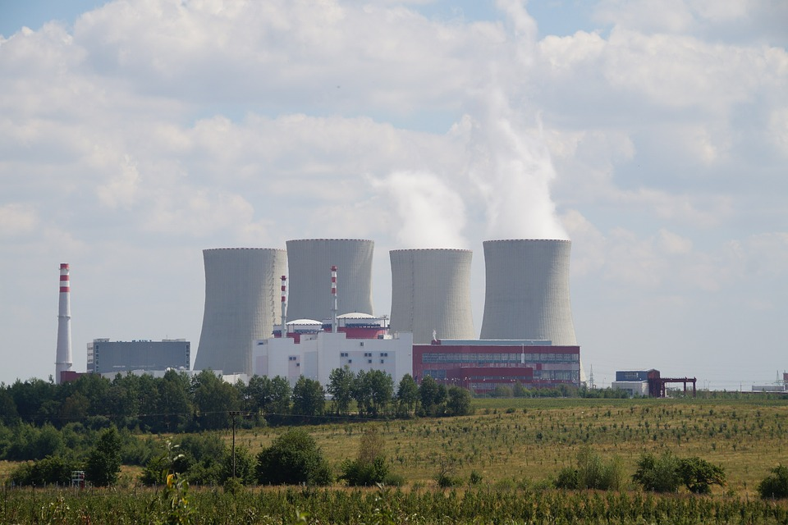
“Unfortunately, we make lots of CO2 which is produced every time we burn a fuel like coal and gas to make electricity.
This is why it is important to design buildings that use less energy for things like lighting and heating.”
Image: Ivabelk; Temline Nuclear POwer station (pixaby.com)
^{RIBA}
^{Learning_Mathematics Activity}

Slide 25
“Our research tells us that a building will lose less heat if the Surface Area is small compared to its Volume.
Heating a building uses energy so a building with a lower Surface to Volume Ratio is better for the Environment.”
Image: Ivabelk; Temline Nuclear POwer station (pixaby.com)
^{RIBA}
^{Learning_Mathematics Activity}

Slide 26
“Look one building is half of a cylinder and the other is half of a sphere.
Therefore you can work out the Surface Area and Volume of your building using your knowledge of mathematics.”
^{RIBA}
^{Learning_Mathematics Activity}

Slide 27
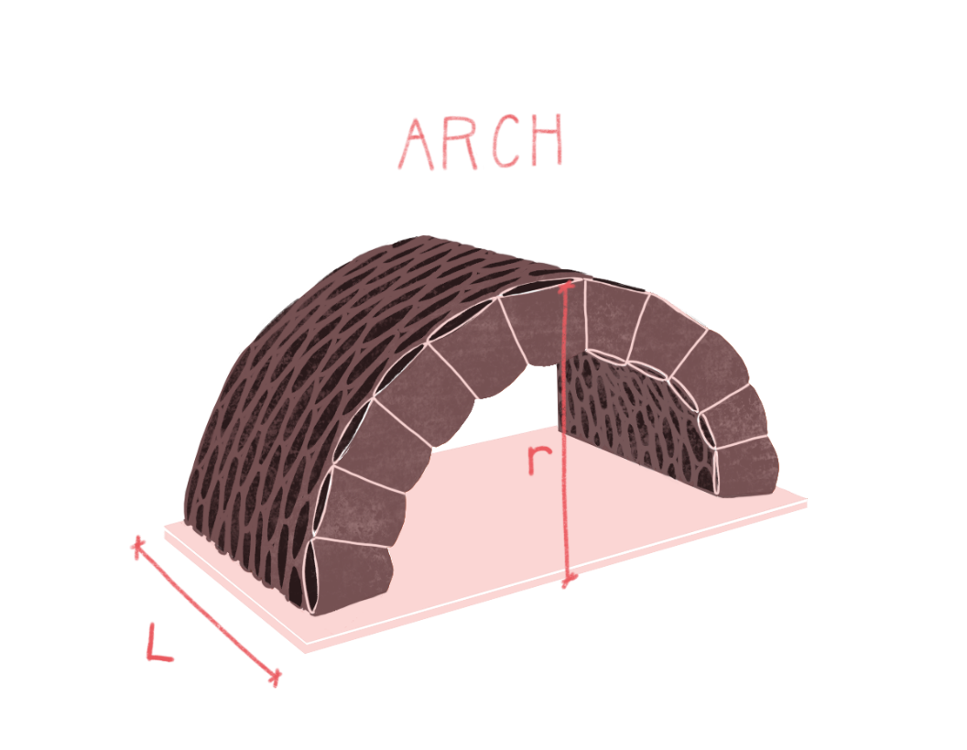

^{‘LET’S DO SOME MATHS!’}
In centimetres, measure the height, H of the building and it’s length, L.
Use the formula to work out the Surface Area, S the Volume, V and the Surface Area to Volume Ratio, R.
^{RIBA}
^{Learning_Mathematics Activity}

Slide 28
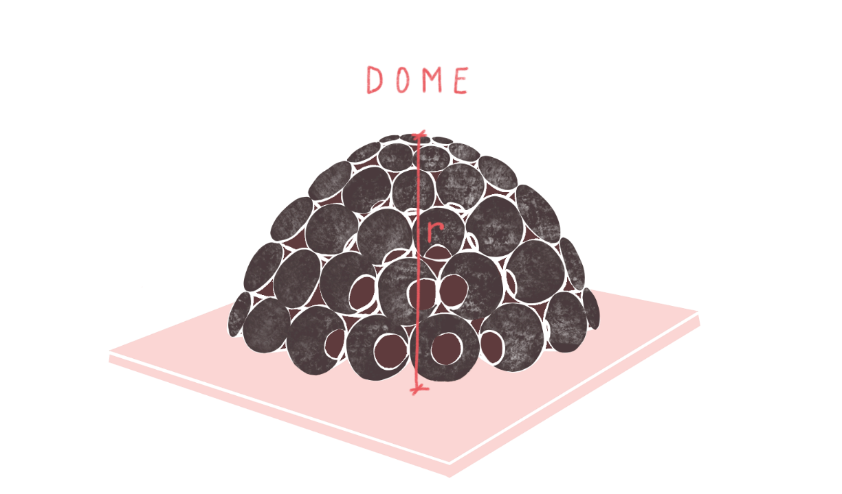


^{‘LET’S DO SOME MATHS!’}
In centimetres, measure the height of the building this will be the radius of the sphere.
Use the formula to work out the Surface Area, S the Volume, V and the Surface Area to Volume Ratio, R
^{RIBA}
^{Learning_Mathematics Activity}

Slide 29
“Which building form can provide the best energy performance
^{Sophie}
^{Tomas}
^{RIBA}
^{Learning_Mathematics Activity}

