Slide 1
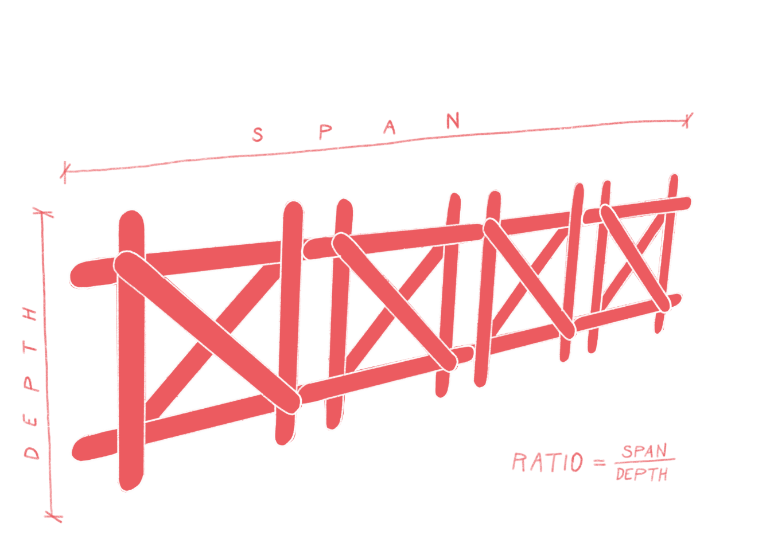

Bridges
^{‘LET’S DO SOME MATHS!’}
KS2 | Learning Points
Architecture | Learning Points
Operations
Measurement
Units
Fractions
Formulae
Parabolas
Plotting Curves
Geometry
Ratio
Structures
Materials
Form
Transport
Environment
Making
Quality
^{RIBA}
^{Learning_Mathematics Activity}

Slide 2
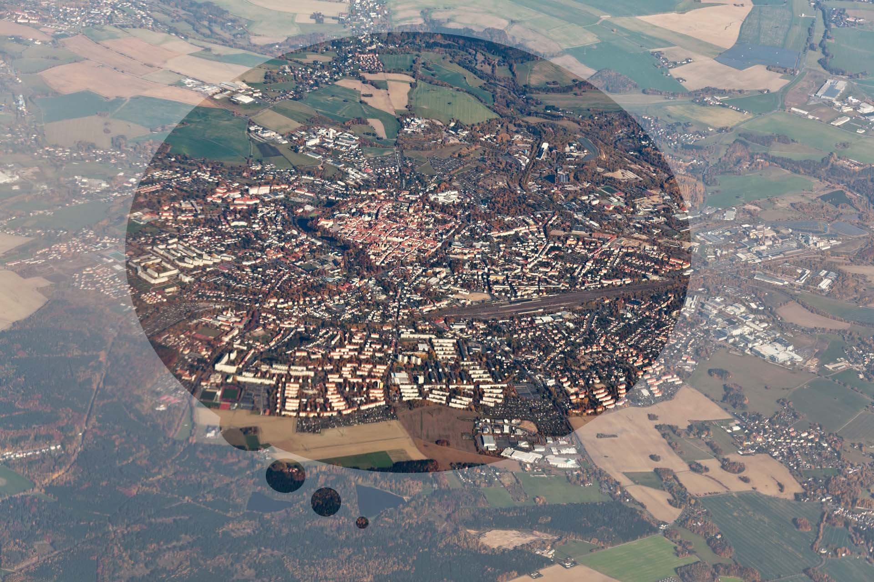
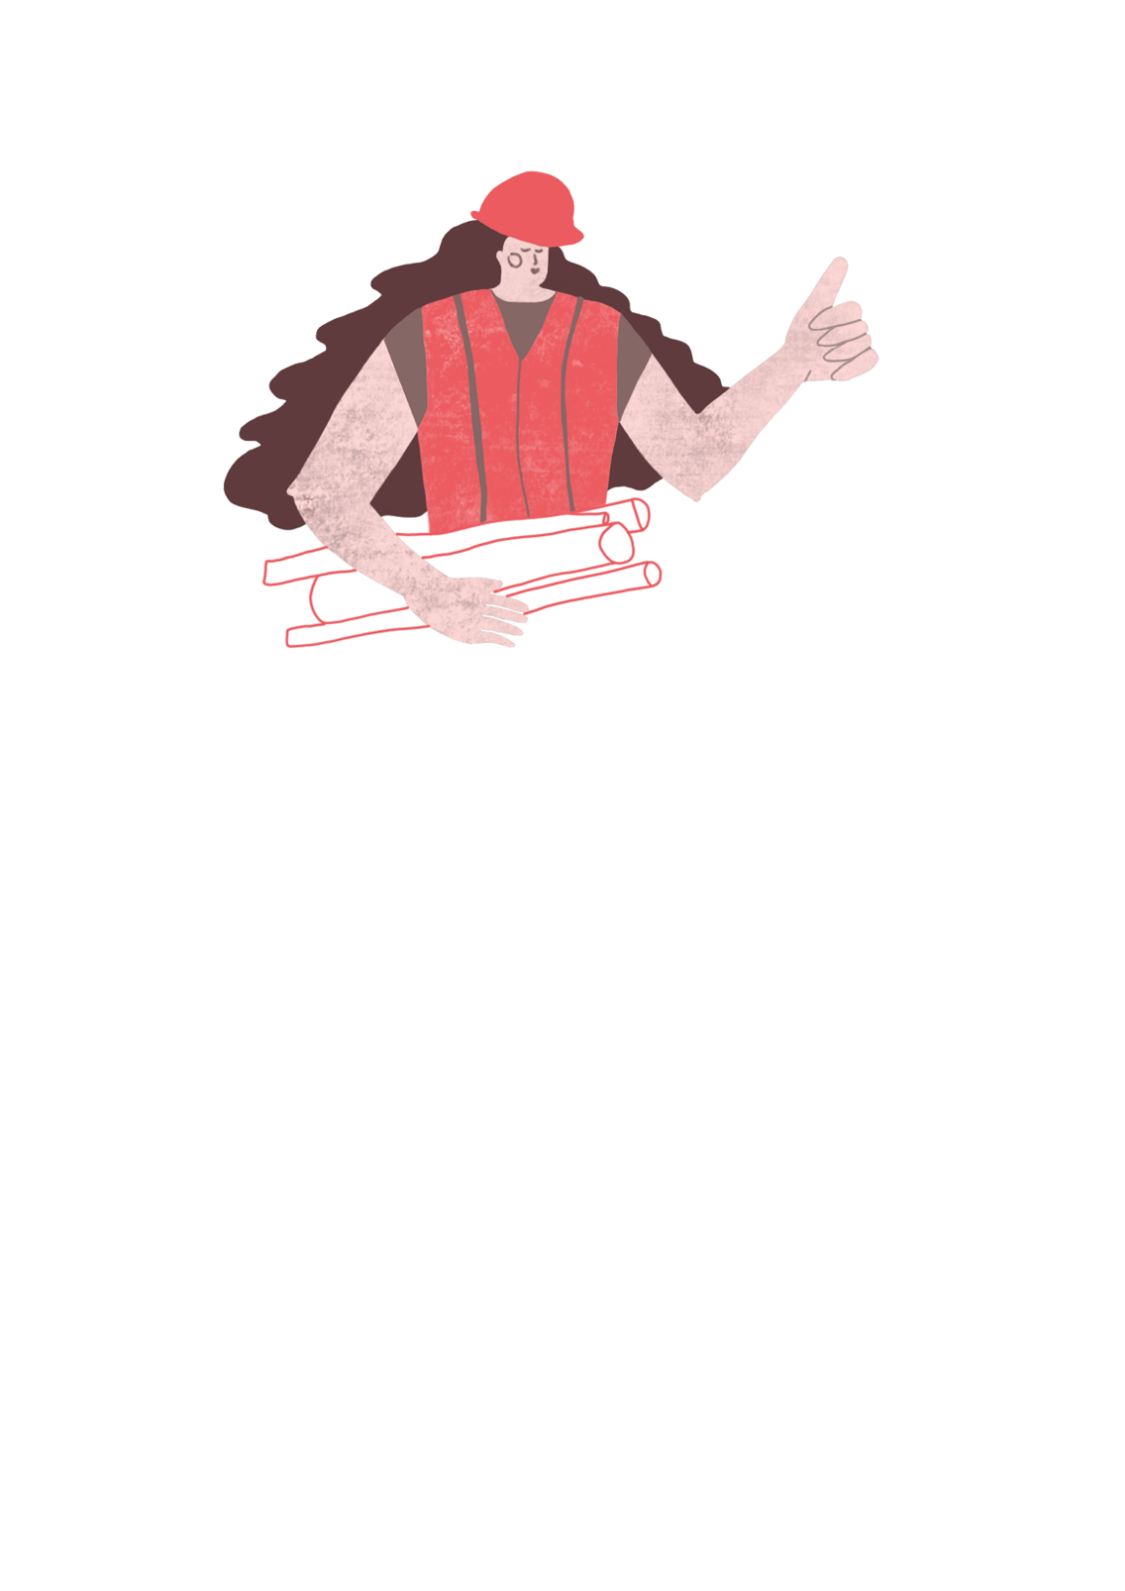
Architects design the buildings and places where we live, work and love to visit.
^{RIBA}
^{Learning_Mathematics Activity}

Slide 3
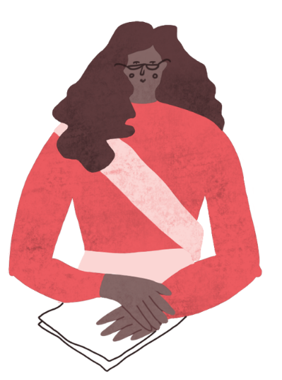

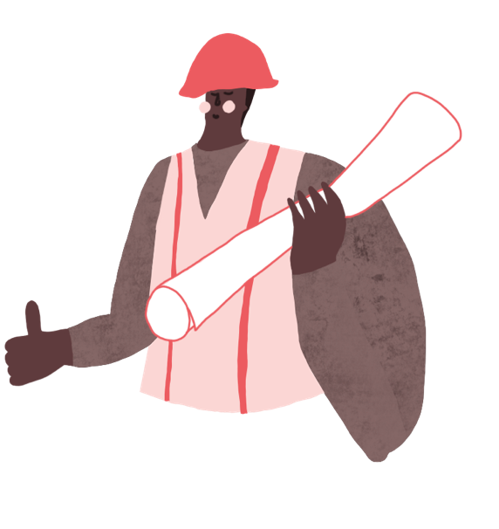
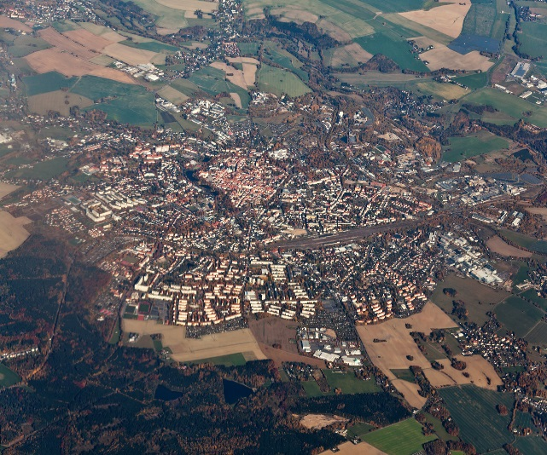
“Sophie and Tomas are architects who live in the City of Towncaster, where they work with the community, their friends and the Mayor of Greater Towncaster.”
^{Sophie}
^{Tomas}
^{RIBA}
^{Learning_Mathematics Activity}
^{Towncaster}

Slide 4
Sophie and Tomas enjoy creating places which you can enjoy too!
^{Sophie}
^{Tomas}
^{RIBA}
^{Learning_Mathematics Activity}
^{Towncaster}

Slide 5
“ Architects need to know about lots of different things such as people’s needs, how to make things and how much things will cost.”
^{Sophie}
^{Tomas}
^{RIBA}
^{Learning_Mathematics Activity}
^{Towncaster}

Slide 6
“ Architects need to know about lots of different things such as people’s needs, how to make things and how much things will cost.”
“On the exciting architecture projects we’re designing for Towncaster, we need to use mathematics to help work things out and would like you to help us with our sums.”
^{Sophie}
^{Tomas}
^{RIBA}
^{Learning_Mathematics Activity}
^{Towncaster}

Slide 7
Architects Sophie and Tomas have been asked by the Mayor of Towncaster to design a new Road Bridge for the city market which can be:
_Long enough and high enough to cross the river
_Strong enough to carry heavy vehicles
_Light enough to save on materials
_A beautiful and graceful structure for the City of Towncaster.
^{RIBA}
^{Learning_Mathematics Activity}

Slide 8
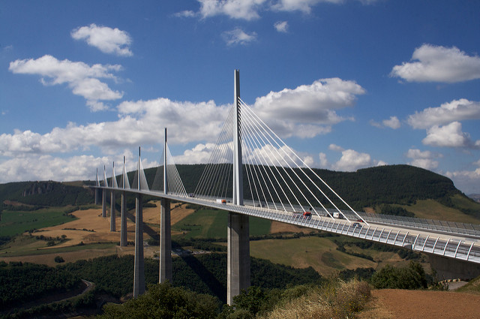
“Towncaster is a thriving city and needs to be connected to the regions of our nation.
But our roads are out of date and we need a new road bridge to span the river.”
Image: Richard Leeming, 2008: Milau Viaduct (flikr.com)
^{RIBA}
^{Learning_Mathematics Activity}

Slide 9
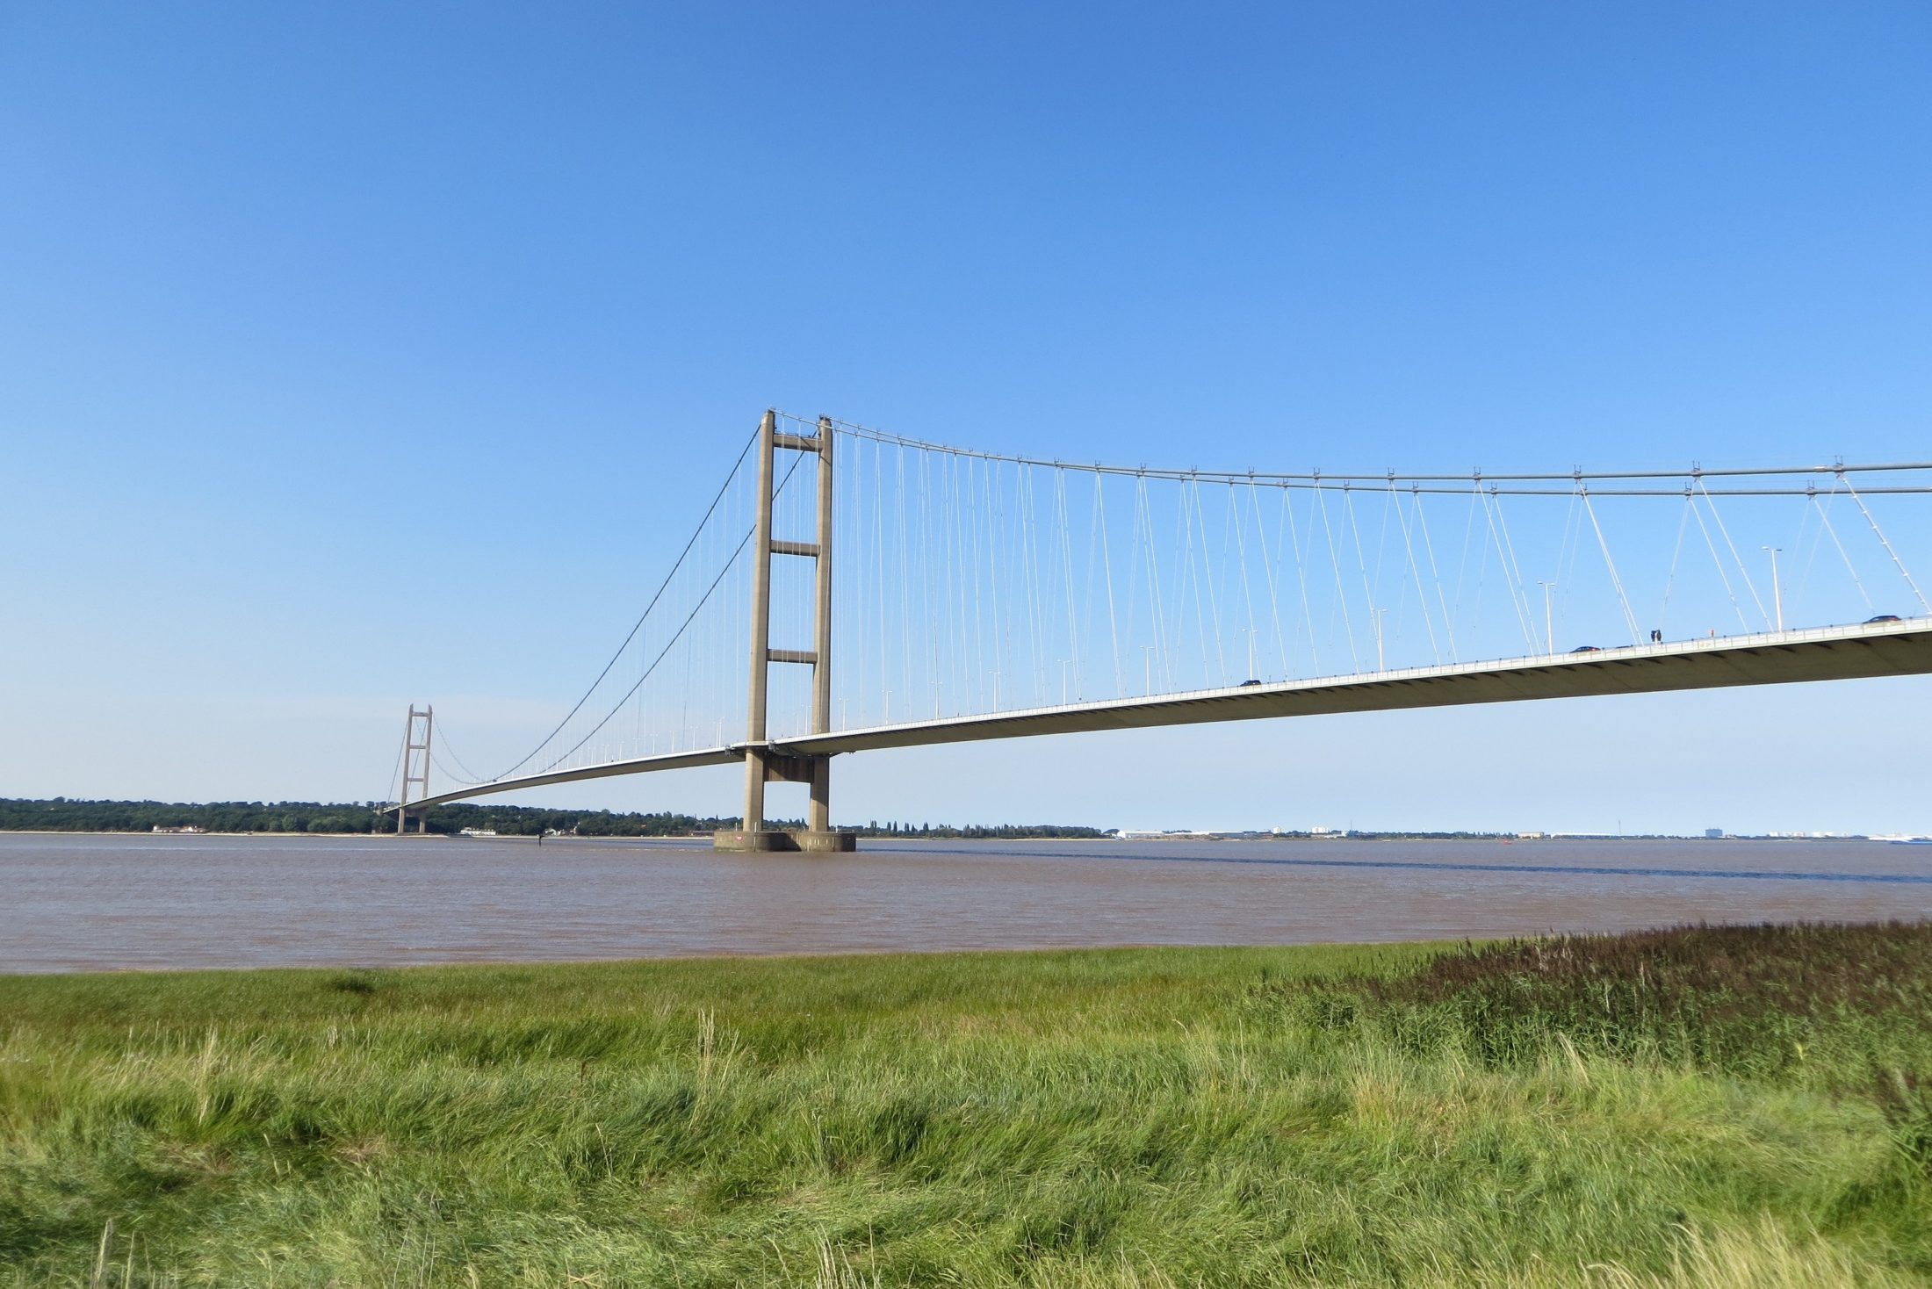
“Towncaster, needs a new road bridge.
A bridge for vehicles such as cars and lorries can be light and flexible like a suspension bridge”
Image: Alex Levitt, 2015: Humber Bridge (commons.wikimedia.org)
^{RIBA}
^{Learning_Mathematics Activity}

Slide 10
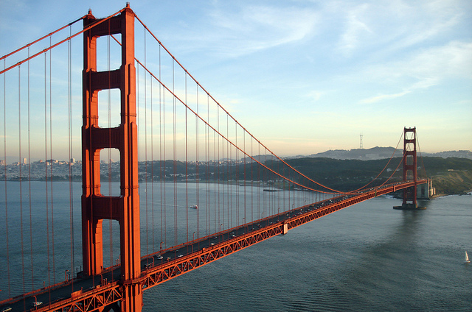
“The cables of a suspension bridge form a curve called a Parabola.
There is a mathematical formula for parabolas which we can use to plot the curve we need to design a suspension bridge.”
Image: Rich Niewiroski Jr., 2015: Golden Gate Bridge, (flikr.com)
^{RIBA}
^{Learning_Mathematics Activity}

Slide 11
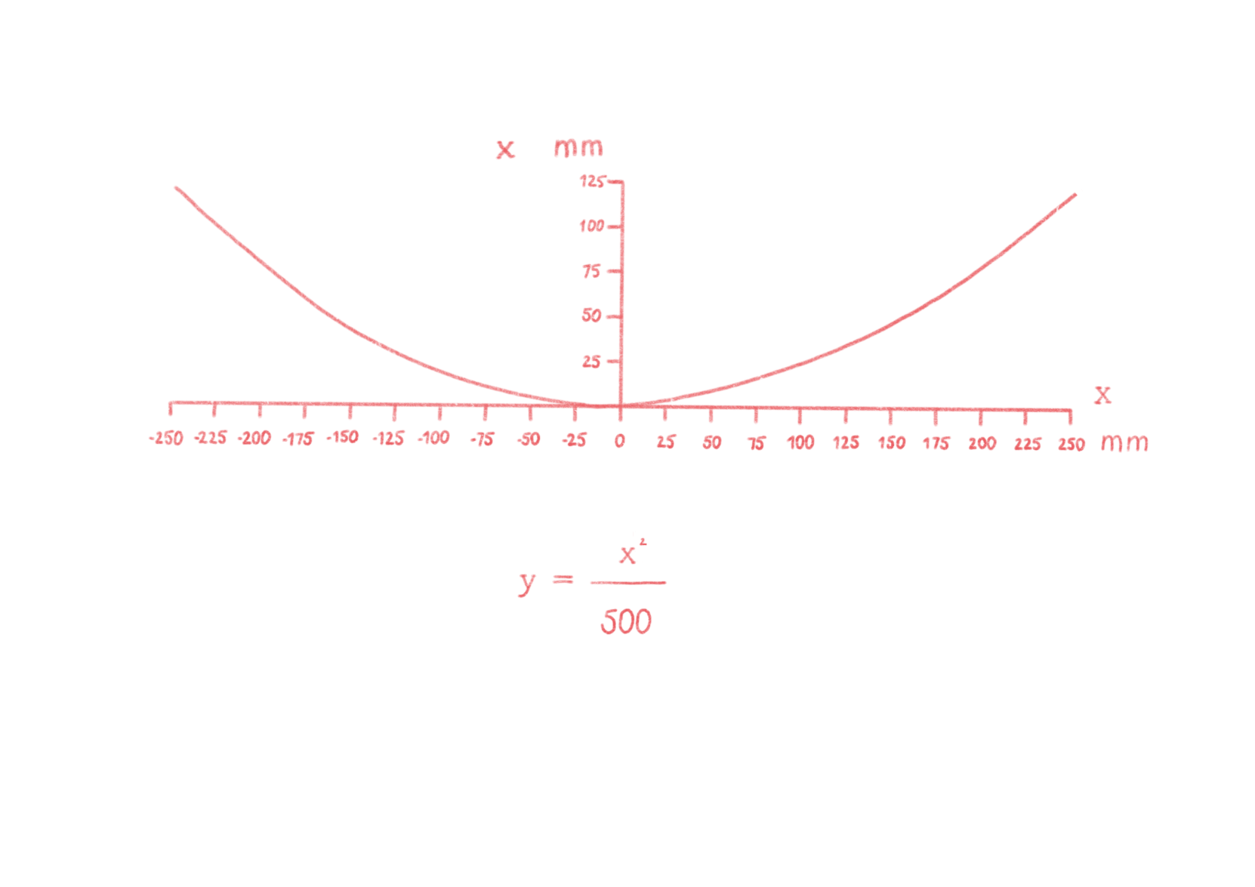
^{Sophie}
Using this formula for a parabola, plot a curve on a large sheet of paper.
^{Tomas}
^{RIBA}
^{Learning_Mathematics Activity}

Slide 12
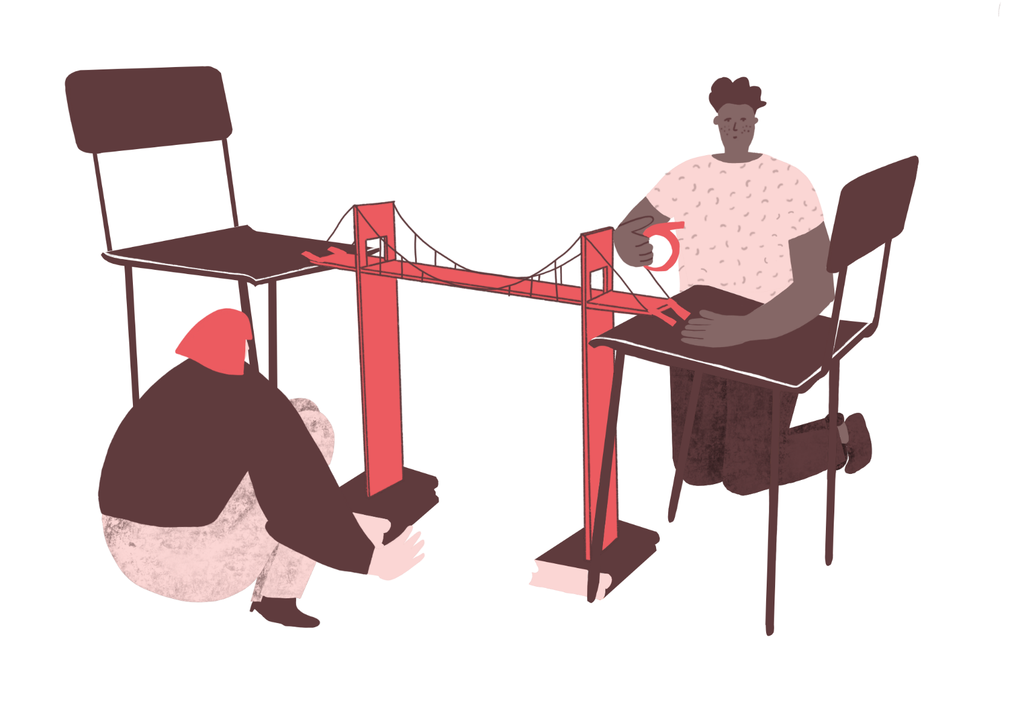
“Because we know the formula, we can build a model to prove that the design works.
We can build this using just cardboard, paper and some sticky tape.”
^{Tomas}
^{RIBA}
^{Learning_Mathematics Activity}

Slide 13
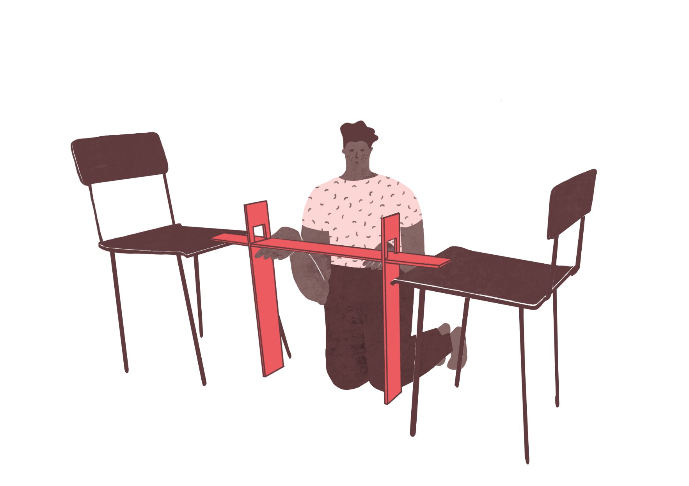
“First test the bridge without the
suspension cables.
You can use toy cars for this.”
^{Sophie}
^{RIBA}
^{Learning_Mathematics Activity}

Slide 14
“First test the bridge without the
suspension cables.
You can use toy cars for this.”
“Now firmly attach the suspension cables to it.
Does it work much better? See how much weight you can add.”
^{Sophie}
^{Tomas}
^{RIBA}
^{Learning_Mathematics Activity}

Slide 15

What a beautiful road bridge but Towncaster really needs a railway connection as well. Also, rail travel is better for the environment.
^{Sophie}
^{Tomas}
^{RIBA}
^{Learning_Mathematics Activity}

Slide 16
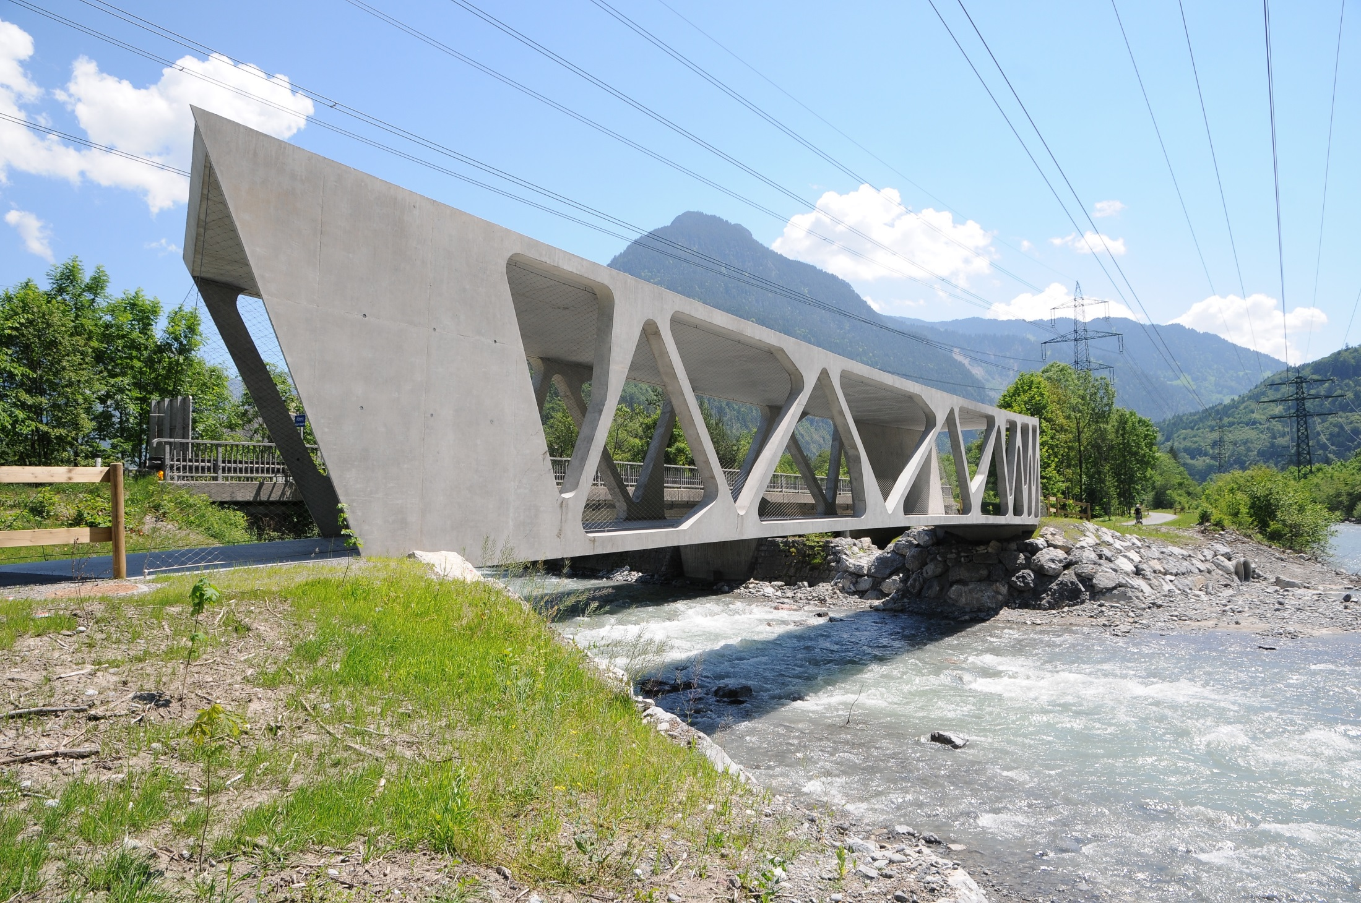
“We agree, but we will need a different design for a rail bridge as the light weight structure for road bridges is too flexible to carry long, heavy trains.”
Image: Bohringer Friedrich, 2011: Alfenzbrücke_Lorüns, (commons.wikimedia.org)
^{RIBA}
^{Learning_Mathematics Activity}

Slide 17
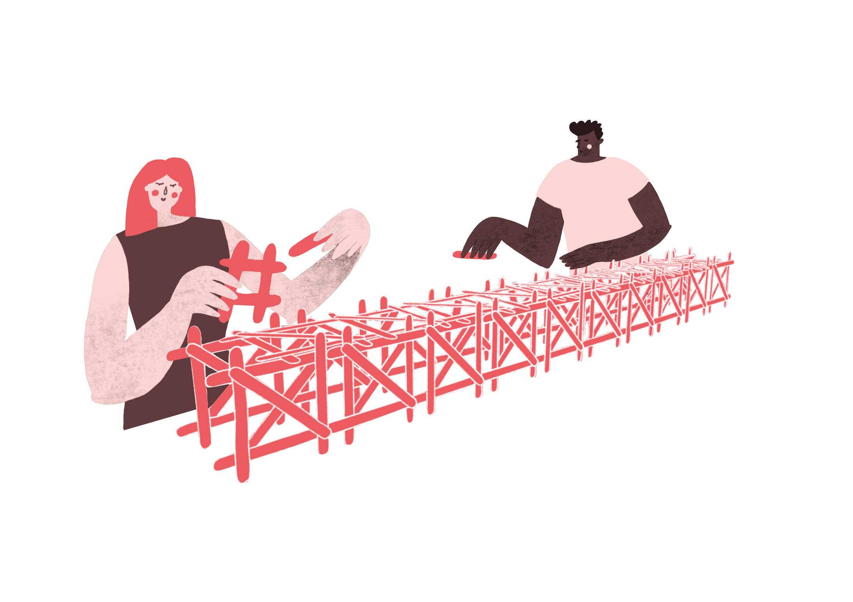
“We can use lollypop stick to make a model of a railway bridge.
Engineers call this type of structure a truss. It works like a giant beam. The triangles make the structure very rigid.”
^{RIBA}
^{Learning_Mathematics Activity}

Slide 18
“For a beam we call its length the ‘span’. For a given span, the depth of the beam will determine how rigid it is. If it’s deeper it will be stronger but use more material and be heavier."
^{RIBA}
^{Learning_Mathematics Activity}

Slide 19
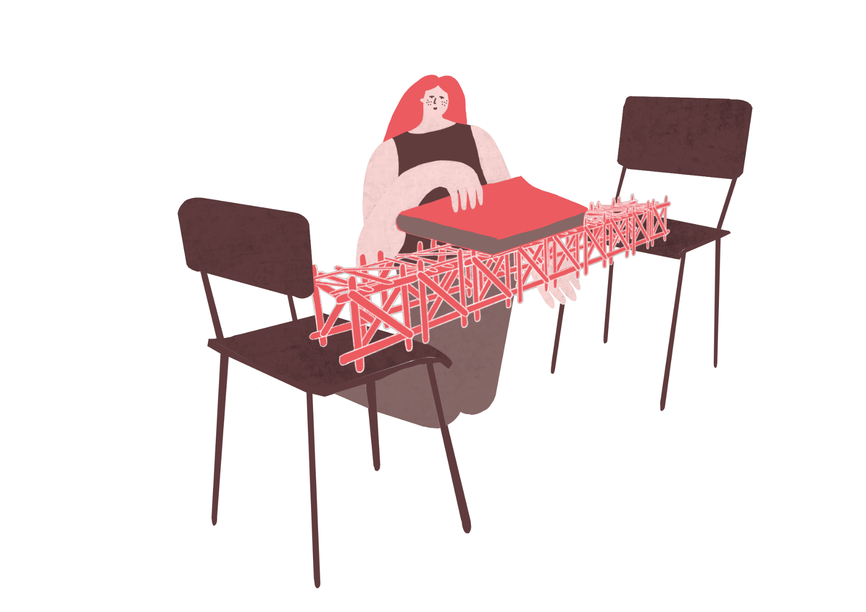
“From our research we think a Span to Depth ratio, R for a bridge like this could be 10.
If we know this can we work out how many lollypop sticks we need?”
^{RIBA}
^{Learning_Mathematics Activity}

Slide 20
“We can connect these together to make a strong, rigid, bridge suitable for trains.
Test to see if it stronger than the suspension bridge. How did we do?”
^{RIBA}
^{Learning_Mathematics Activity}

