Slide 1
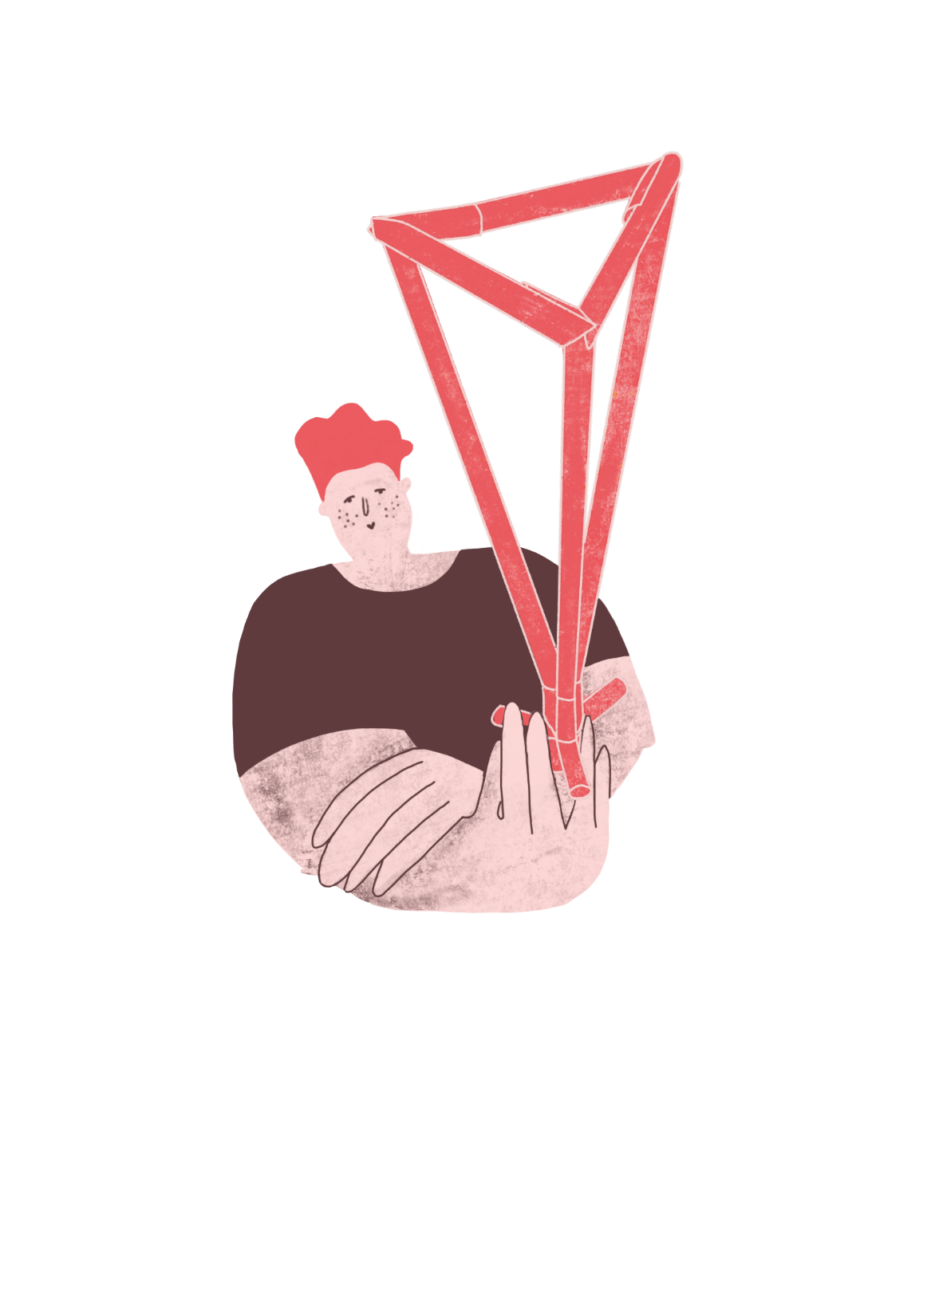
Market Hall
^{‘LET’S DO SOME MATHS!’}
KS2 | Learning Points
Architecture | Learning Points
Numbers
Units
Decimals
Operations
Measurement
Formulae
Currency
Geometry
Proportion
Structures
Materials
Form and Aesthetics
Space Planning
Economics
Making
^{RIBA}
^{Learning_Mathematics Activity}

Slide 2
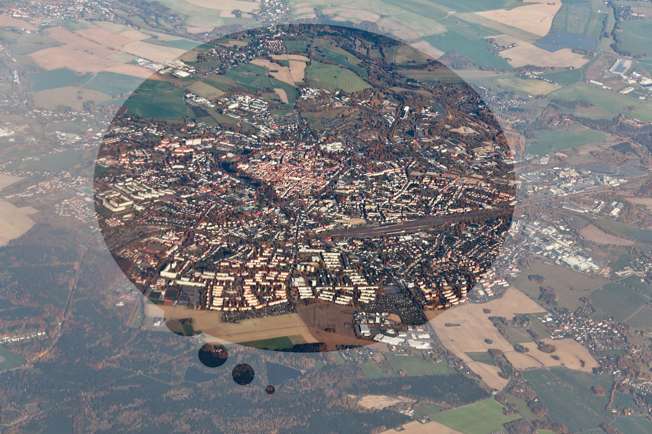
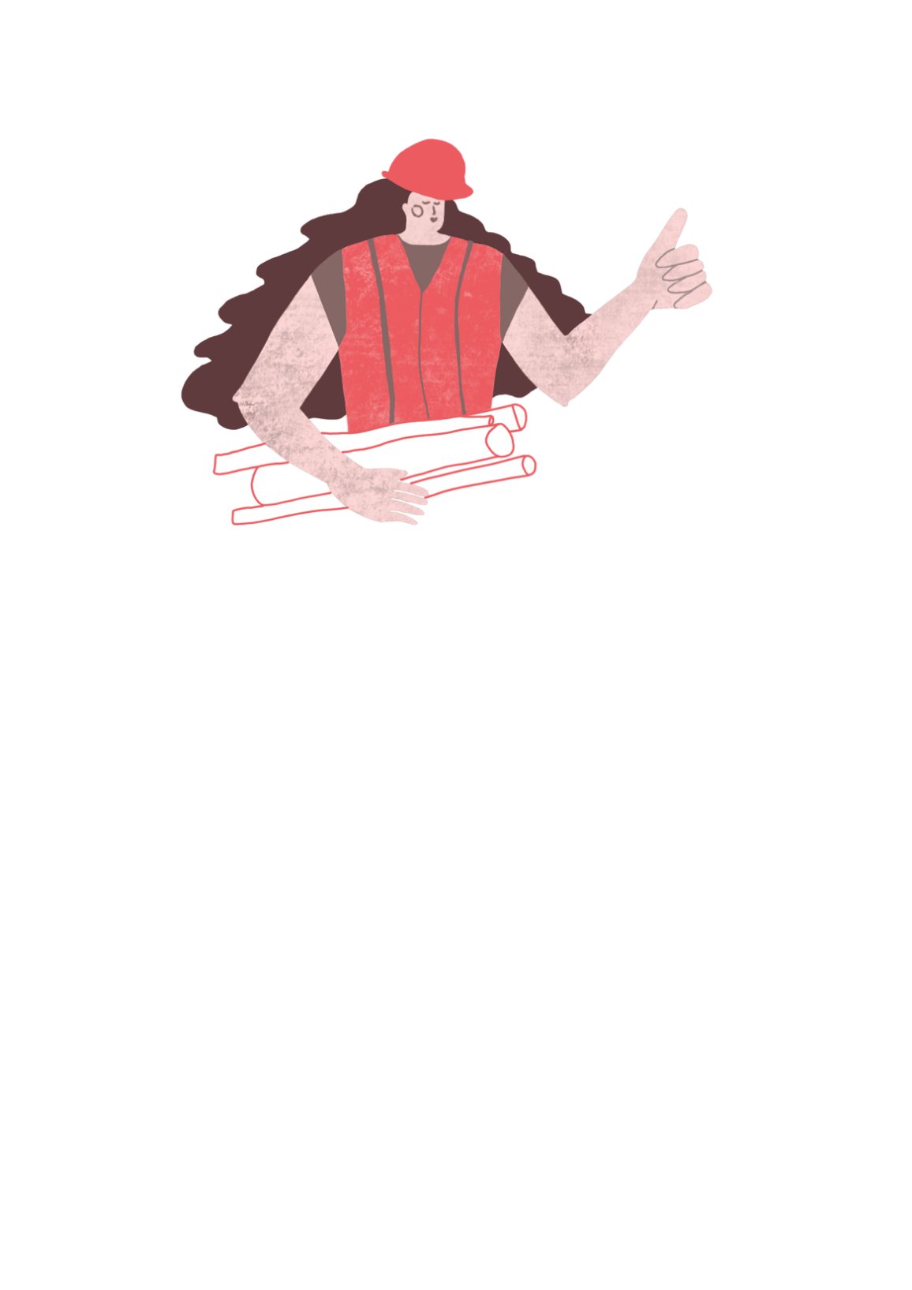
Architects design the buildings and places where we live, work and love to visit.
^{RIBA}
^{Learning_Mathematics Activity}

Slide 3
“Sophie and Tomas are architects who live in the City of Towncaster, where they work with the community, their friends and the Mayor of Greater Towncaster.”
^{Sophie}
^{Tomas}
^{RIBA}
^{Learning_Mathematics Activity}
^{Towncaster}

Slide 4
Sophie and Tomas enjoy creating places which you can enjoy too!
^{Sophie}
^{Tomas}
^{RIBA}
^{Learning_Mathematics Activity}
^{Towncaster}

Slide 5
“ Architects need to know about lots of different things such as peoples’ needs, how to make things and how much things will cost.”
^{Sophie}
^{Tomas}
^{RIBA}
^{Learning_Mathematics Activity}
^{Towncaster}

Slide 6
“ Architects need to know about lots of different things such as peoples’ needs, how to make things and how much things will cost.”
“On the exciting architecture projects we’re designing for Towncaster, we need to use mathematics to help work things out and would like you to help us with our sums.”
^{Sophie}
^{Tomas}
^{RIBA}
^{Learning_Mathematics Activity}
^{Towncaster}

Slide 7
Architects Sophie and Tomas have been asked by the Mayor of Towncaster to design a new Market Hall for the city market which can provide:
Shelter from the weather
Lots of natural light
A modern new facility to celebrate the city’s thriving economy
A great selection of stalls for everyday shopping and special treats
A great day out with entertainment and places to eat
^{RIBA}
^{Learning_Mathematics Activity}

Slide 8
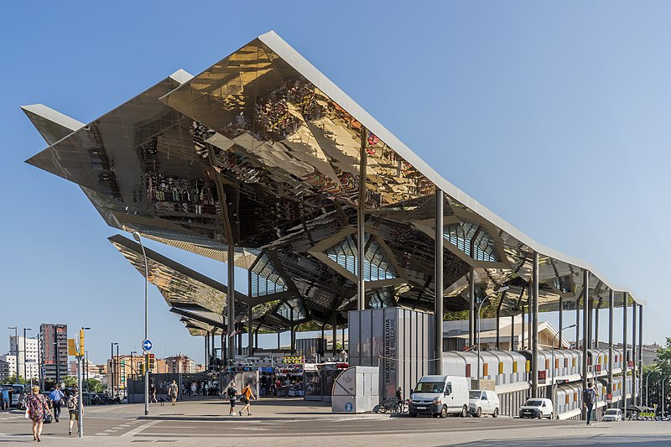
“The Towncaster Market Hall is very dark and nobody wants to go there anymore. I wish the city had a modern, bright market. I’ll ask Sophie and Tomas what we should do about it.”
Image: Thomas Ledl, 2018: Mercat dels Encants, Barcelona (commons.wikimedia.org)
^{RIBA}
^{Learning_Mathematics Activity}

Slide 9
“A market place is the centre of a vibrant and successful city like Towncaster, it should be full of people spending money on groceries and other things they want in a beautiful light filled space.”
Image: Thomas Ledl, 2018: Mercat dels Encants, Barcelona (commons.wikimedia.org)
^{RIBA}
^{Learning_Mathematics Activity}

Slide 10
“Yes it’s a place where people can buy things they need but also enjoy themselves as well. My daughter Sam loves to go to the market with her friend Peiter to get their hair done have a meal at the café. She always brings me home a beautiful bunch of flowers.”
Image: Cindy Gustafson (pexels.com)
^{RIBA}
^{Learning_Mathematics Activity}

Slide 11
“Petals and leaves, what a great idea for a canopy on stalks which can float over all over the market stalls. I think it might be an expensive project, so we will need some help to work this out.”
Image: Cindy Gustafson (pexels.com)
^{RIBA}
^{Learning_Mathematics Activity}

Slide 12
“A new market will need to be big enough to for 40 market stalls. Make sure it works well but only costs £5,000,000, five million pounds and looks fantastic.”
Image: Cindy Gustafson (pexels.com)
^{RIBA}
^{Learning_Mathematics Activity}

Slide 13
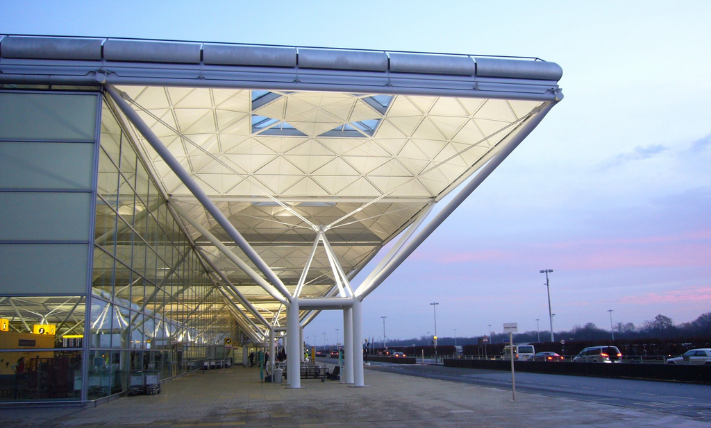
“We can work out what we need by building a model to test out our ideas. Architects like Sophie and I do this all the time”
Image: John Lord, 2008, Stanstead Airport (flikr.com)
^{RIBA}
^{Learning_Mathematics Activity}

Slide 14
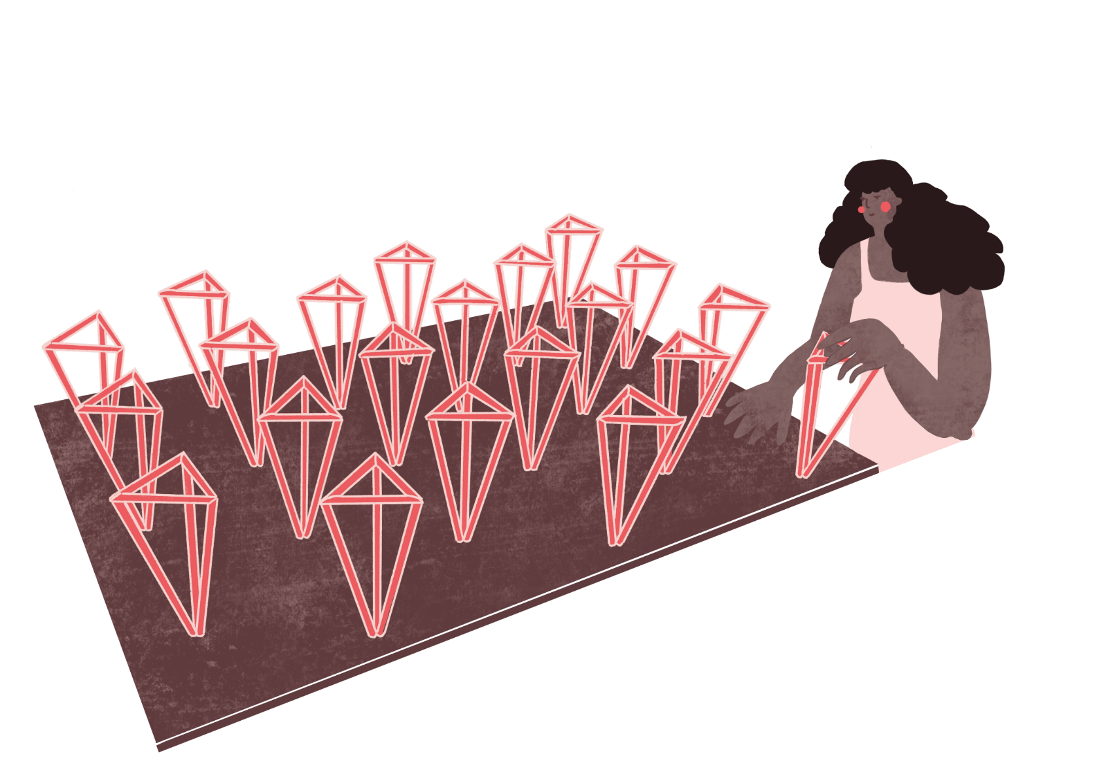
“We are going to make ‘stalks’ or columns for our canopy using straws which we can fix to a big piece of cardboard which is going to be the ground.”
^{Sophie}
^{RIBA}
^{Learning_Mathematics Activity}

Slide 15
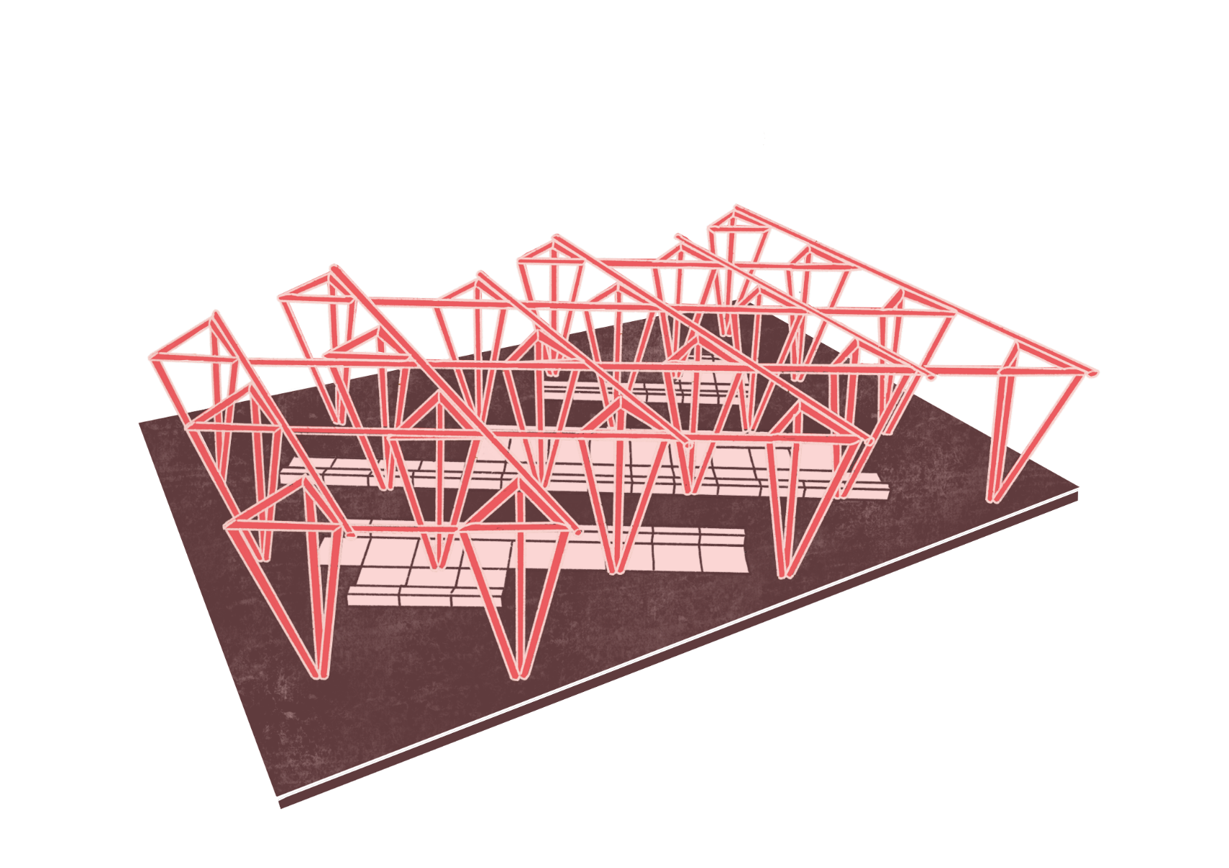
“That looks very effective. The triangle shapes will make the structure light and strong. Look, we can use the model to show where we can put the market stalls.”
^{Sophie}
^{RIBA}
^{Learning_Mathematics Activity}

Slide 16
“Finally we can add our petals and leaves to create a beautiful roof on our model.”
^{Sophie}
^{RIBA}
^{Learning_Mathematics Activity}

Slide 17
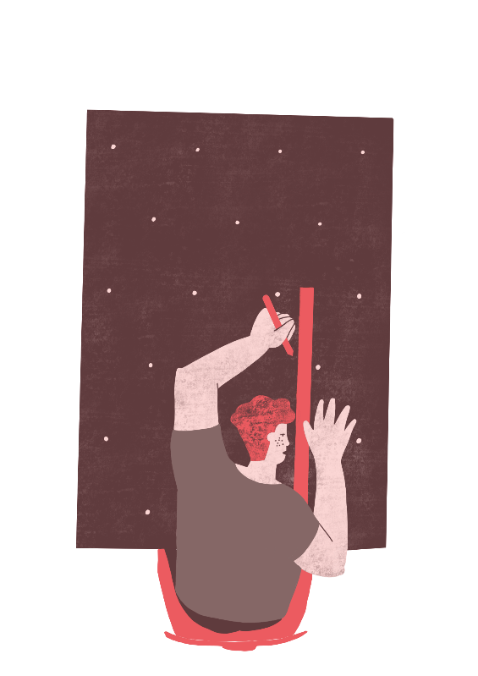
What a useful model. Can we use it to work out how much the project will cost and if we have enough room for all the stalls we need?
^{Sophie}
^{Tomas}
^{RIBA}
^{Learning_Mathematics Activity}

Slide 18
“Our research tells us that each column can be made in Europe, shipped to Towncaster and installed for 90,000 Euros each
A Pound is worth 1.125 Euros.”
Cost of one Column in Euros
Cost of One Column in Pounds = -------------------------------------------
Pounds to Euro Exchange Rate
Cost of columns = Number of Columns x Cost of One Column
^{RIBA}
^{Learning_Mathematics Activity}

Slide 19
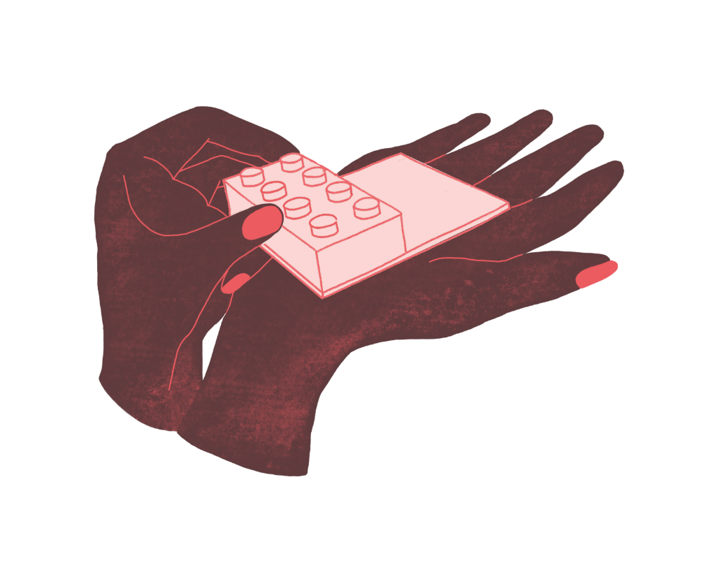
“Our research tells us that each stall can be made on site for £13,500 each.
If we order more than 35 stalls then they cost less at £ £10,500 each.”
Cost of Market Stalls is = Number of Stalls x Cost of One Stall
^{RIBA}
^{Learning_Mathematics Activity}

Slide 20
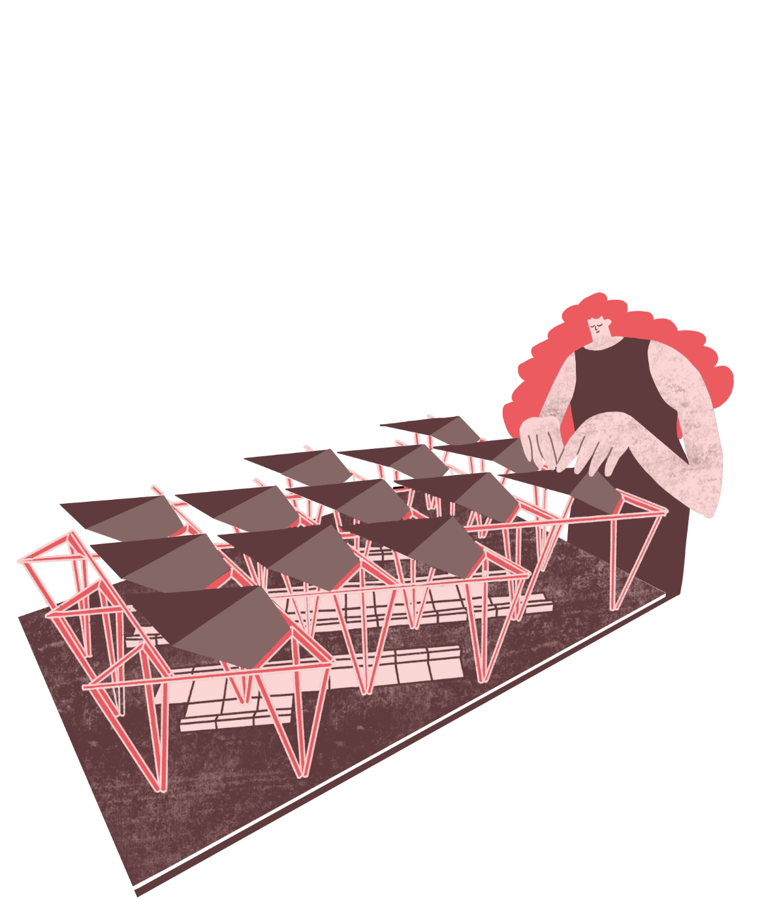
“Our research tells us that the cost to install the roof is £1,200 per square metre.
The scale of the model is 1:100
So, 1cm on your model is 1m in real life.”
Cost of roof is =
Area of Roof x Cost of 1 square metre.
Area of Roof in square meters
Area of Model Roof in square centimetres
^{RIBA}
^{Learning_Mathematics Activity}

Slide 21
“So we can add these up to find the total cost of the new market roof.
How did we do?”
Total Cost of Market Hall =
Cost of Columns
+
Cost of Stalls
+
Cost of Roof
^{RIBA}
^{Learning_Mathematics Activity}

