Slide 1

Homes
^{‘LET’S DO SOME MATHS!’}
KS2 | Learning Points
Architecture | Learning Points
Shapes
Nets
Scale
Scale Translation
Basic Calculations
Calculation Table
Scale
Housing needs
Form
Planning
The Urban Environment
Population
^{RIBA}
^{Learning_Mathematics Activity}

Slide 2
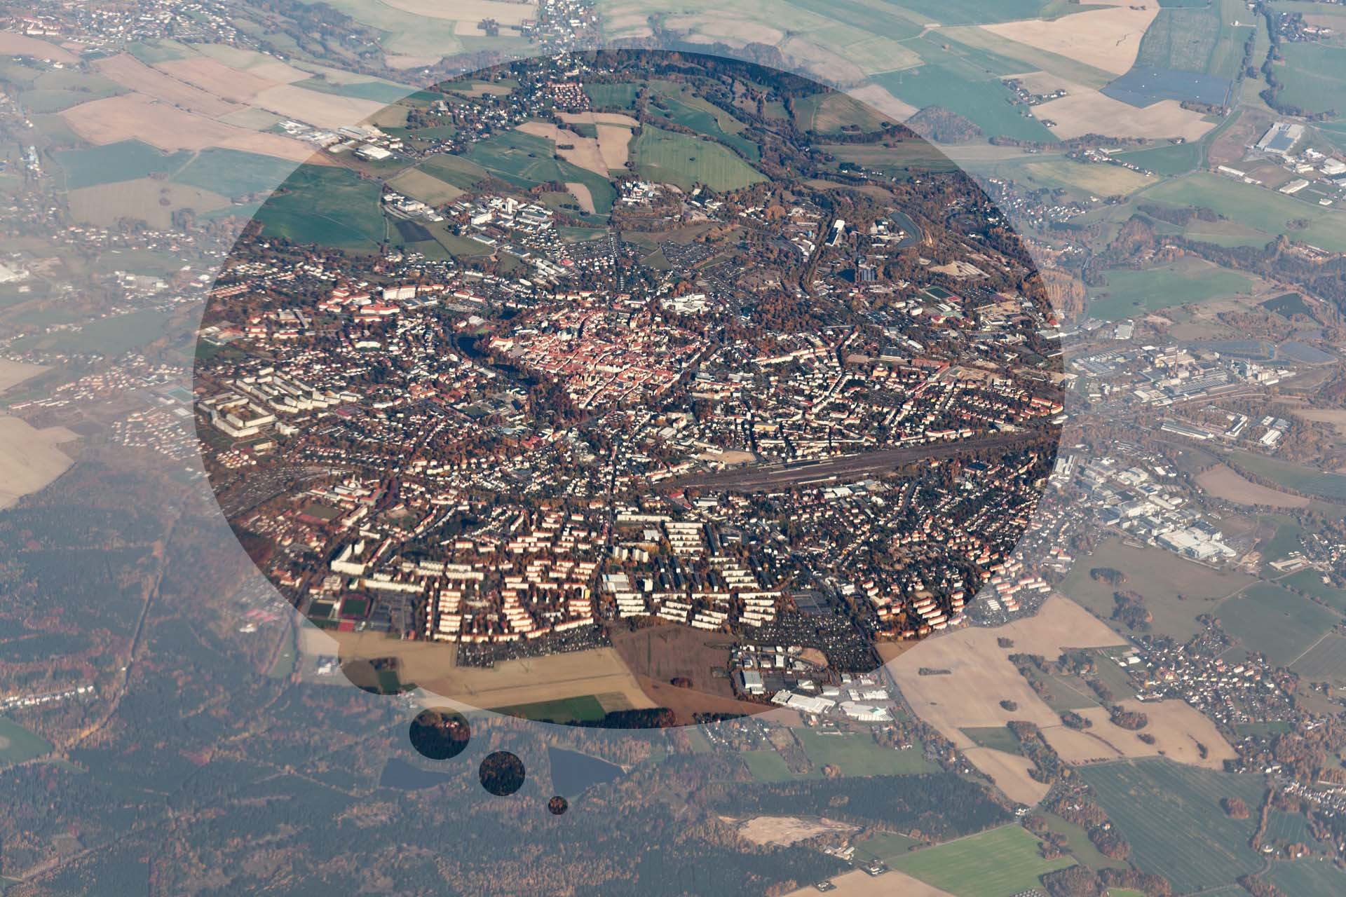
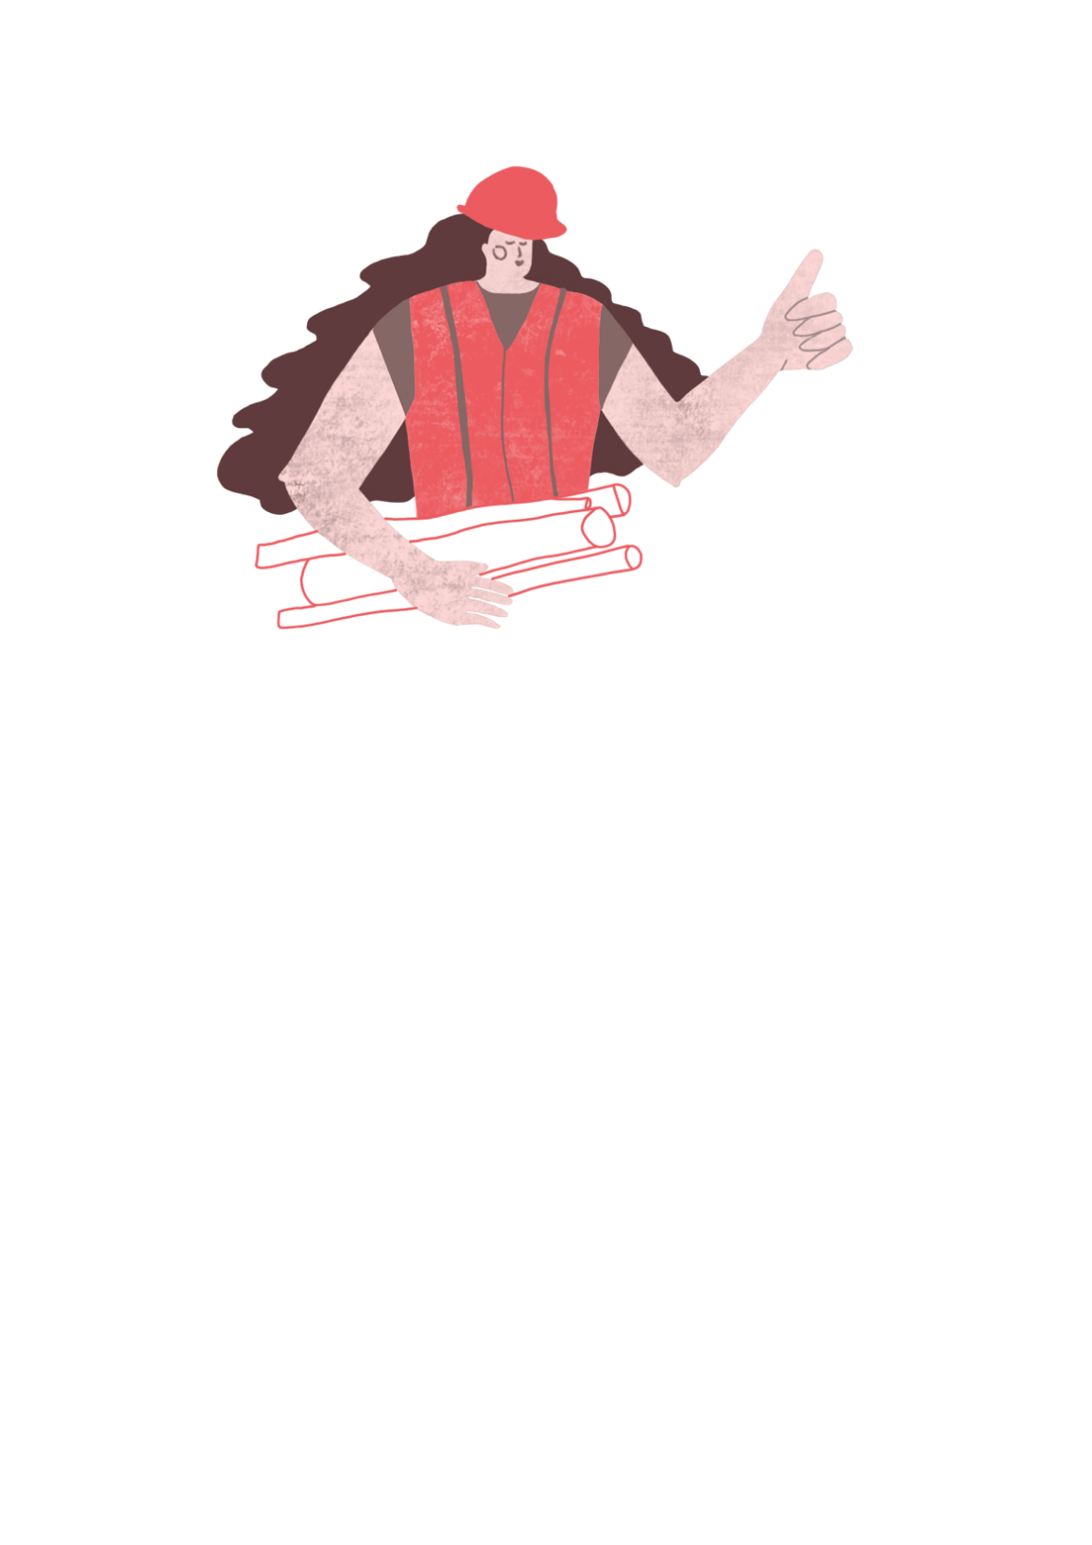
Architects design the buildings and places where we live, work and love to visit.
^{RIBA}
^{Learning_Mathematics Activity}

Slide 3


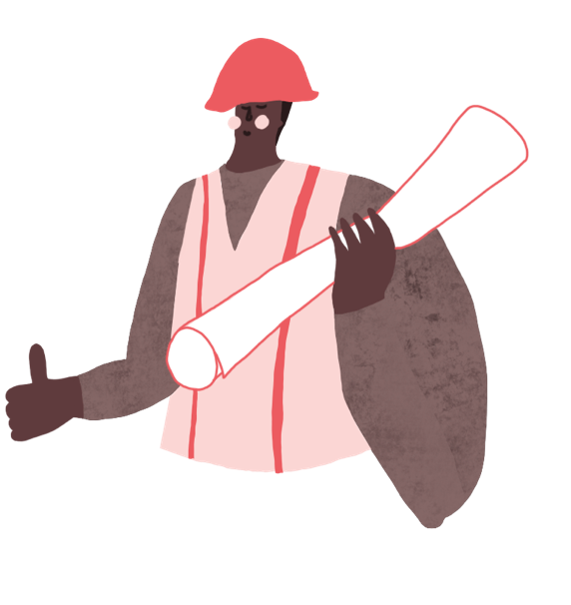
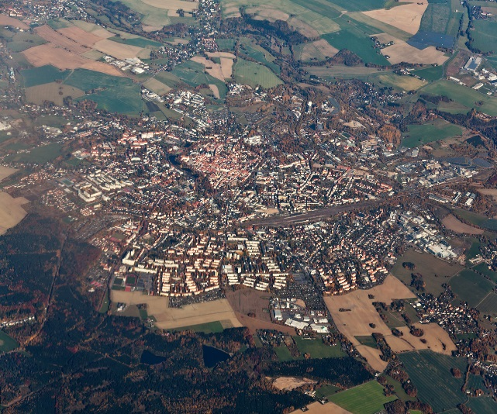
“Sophie and Tomas are architects who live in the City of Towncaster, where they work with the community, their friends and the Mayor of Greater Towncaster.”
^{Sophie}
^{Tomas}
^{RIBA}
^{Learning_Mathematics Activity}
^{Towncaster}

Slide 4
Sophie and Tomas enjoy creating places which you can enjoy too!
^{Sophie}
^{Tomas}
^{RIBA}
^{Learning_Mathematics Activity}
^{Towncaster}

Slide 5
“ Architects need to know about lots of different things such as peoples’ needs, how to make things and how much things will cost.”
^{Sophie}
^{Tomas}
^{RIBA}
^{Learning_Mathematics Activity}
^{Towncaster}

Slide 6
“ Architects need to know about lots of different things such as peoples’ needs, how to make things and how much things will cost.”
“On the exciting architecture projects we’re designing for Towncaster, we need to use mathematics to help work things out and would like you to help us with our sums.”
^{Sophie}
^{Tomas}
^{RIBA}
^{Learning_Mathematics Activity}
^{Towncaster}

Slide 7
Architects Sophie and Tomas have been asked by the Mayor of Towncaster to plan the new homes for the city market which can provide:
Enough homes for an expanding population
A variety of different types of housing for different people with different lives.
Nearby access to shops, transport and things to do
^{RIBA}
^{Learning_Mathematics Activity}

Slide 8

“Towncaster is a thriving city and more people want to live hear than ever before.
We need to make sure we have homes for everyone so I’ll ask Sophie and Tomas to create a plan.”
^{RIBA}
^{Learning_Mathematics Activity}

Slide 9
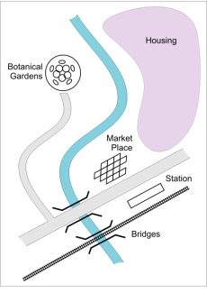
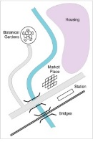
“Architects make plans for towns and cities.
Here’s one we’ve drawn for
Towncaster.”
“To add the housing for the city’s growing population, we’ll need your help to develop the plan.”
^{RIBA}
^{Learning_Mathematics Activity}

Slide 10
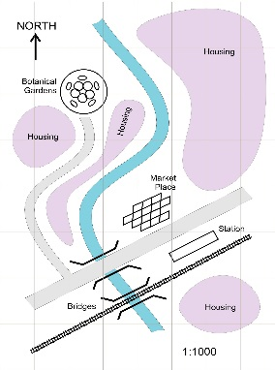
Map scale
1:1000 at A4
“Plans have a scale.
The one you have been given is 1:1000 and fits on an A4 sheet of paper”
“This means everything on the plan is 1,000 times smaller than real life.”
^{RIBA}
^{Learning_Mathematics Activity}

Slide 11

“From this we are going to build a model of Towncaster at a Scale of 1:250.
This means model will be four times bigger than the plan and will fit on an A0 piece of paper”
A0 SCALE 1:250

Slide 12
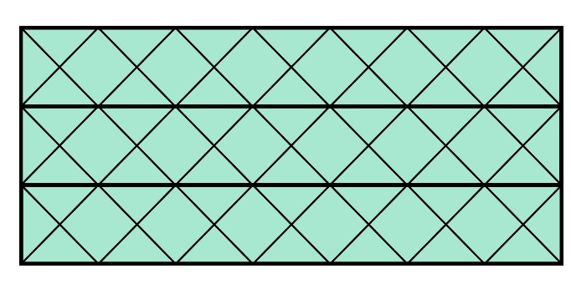
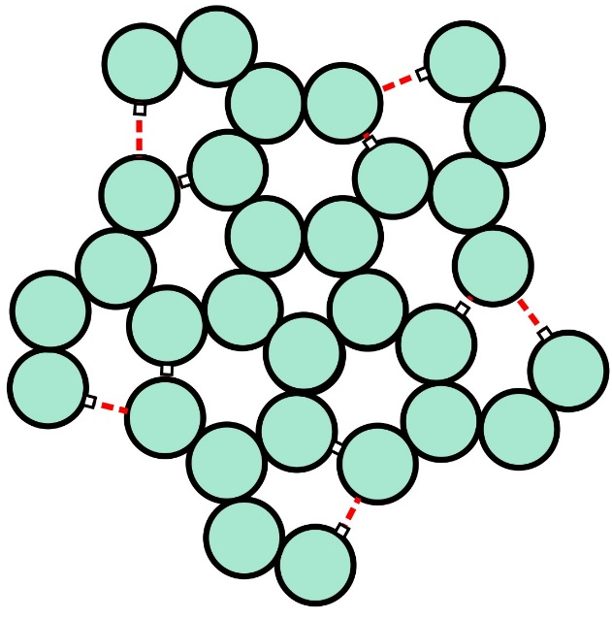
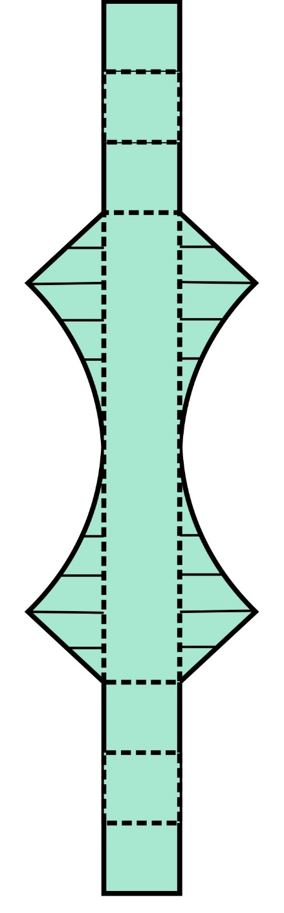
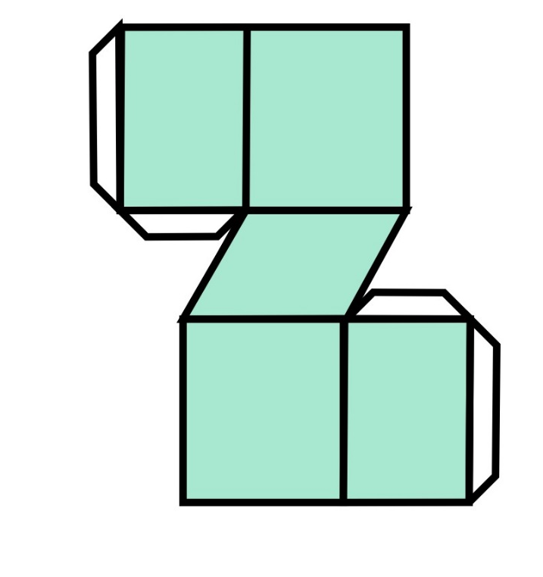
“After you have drawn out the plan on a large sheet of paper.
You can add models of Towncaster’s buildings using the nets you have been provided with.”
^{RIBA}
^{Learning_Mathematics Activity}

Slide 13
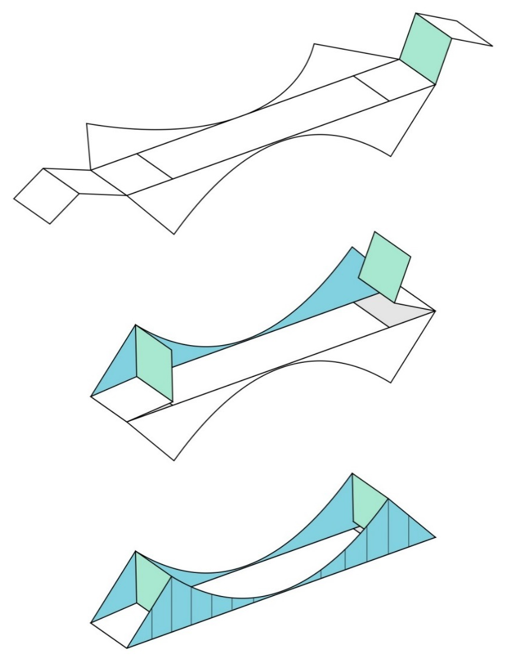
“The nets are shapes you can carefully cut out and then fold into the shapes of buildings and other structures”
^{RIBA}
^{Learning_Mathematics Activity}

Slide 14
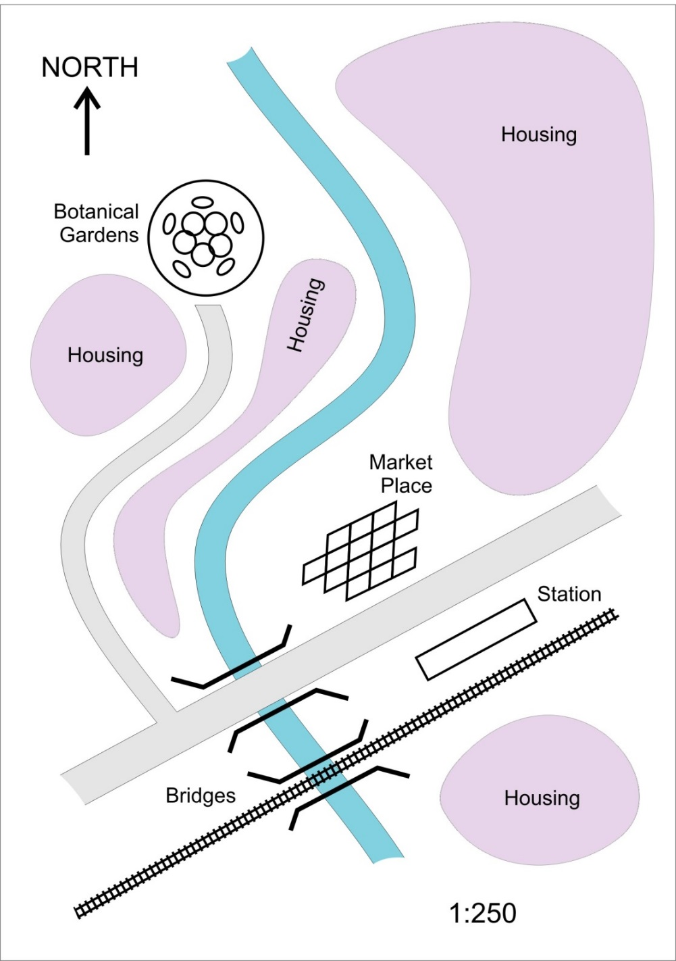
“On the model we have set out some areas especially for housing.”
^{RIBA}
^{Learning_Mathematics Activity}

Slide 15
“We need housing for 2,000 people including elderly people and couples and families with children.”
^{RIBA}
^{Learning_Mathematics Activity}

Slide 16
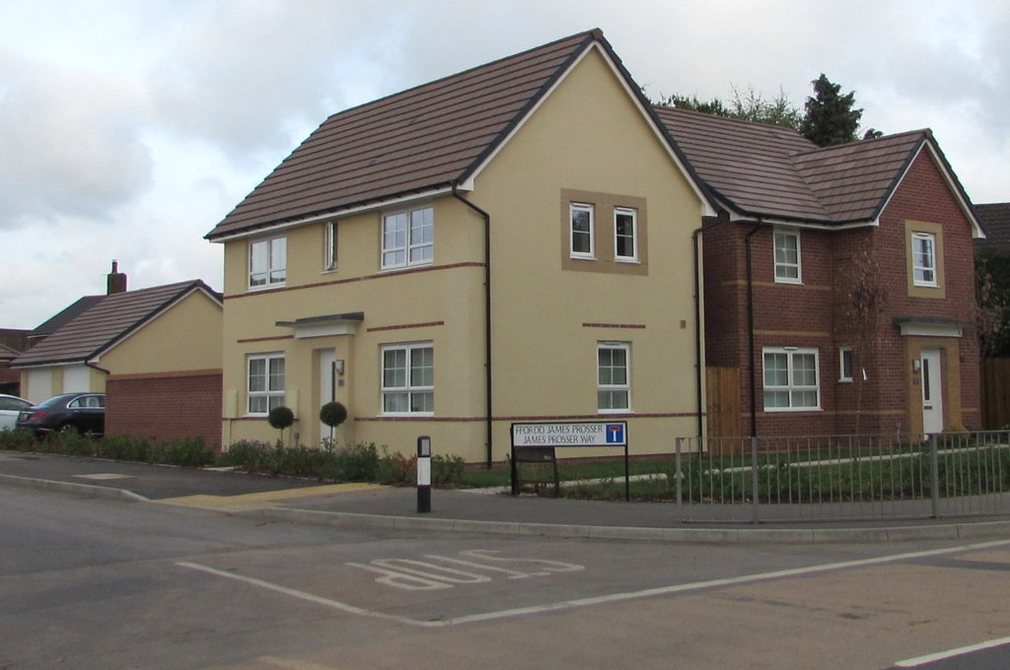
“According to our research –
about 6 people can live in a large house”
Image: Jaggery; New Houses on Lantern Corner Estate (2018)(geograph.org.uk)
^{RIBA}
^{Learning_Mathematics Activity}

Slide 17
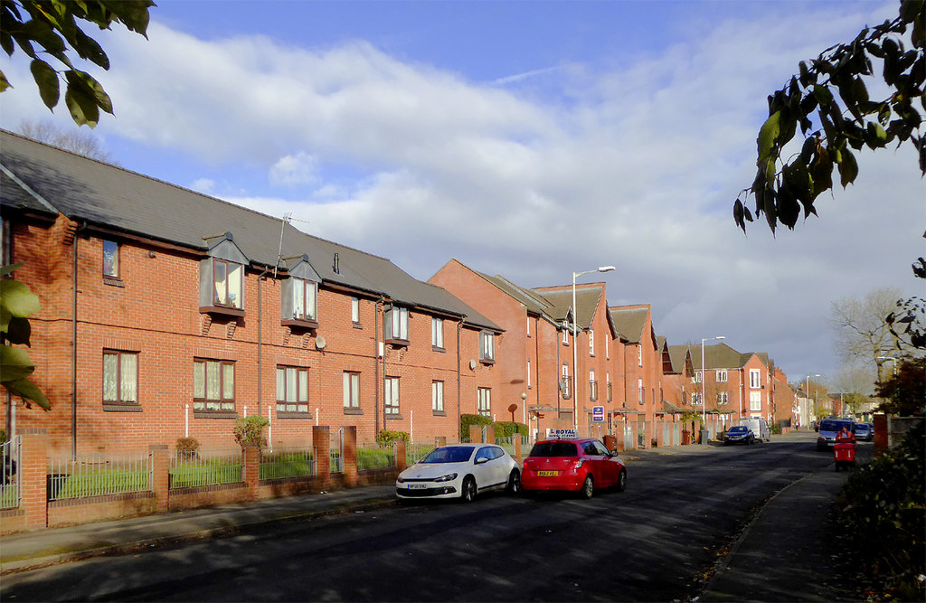
“According to our research –
about 50 people can live in a new street”
Image: Rodger Kidd; Modern housing in Queen Street (2017)(geograph.org.uk)
^{RIBA}
^{Learning_Mathematics Activity}

Slide 18
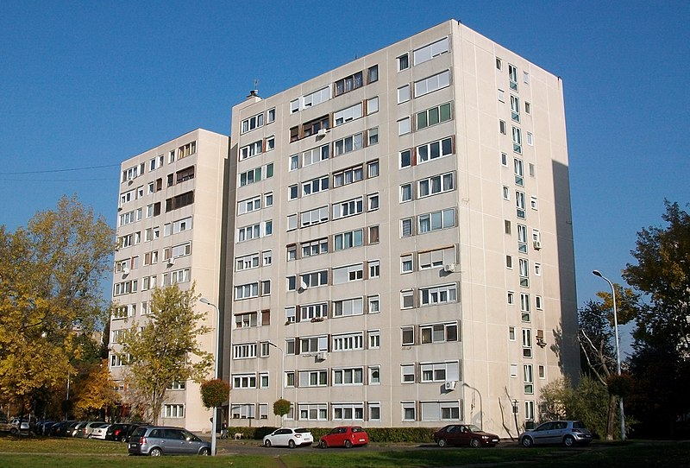
“According to our research –
about 120 people can live in a housing block”
Image: Rodger Rovibroni (Barna Rovács); Larsen-Nielsen-type (Danish) panel building (2015) (wikipedia.org)
^{RIBA}
^{Learning_Mathematics Activity}

Slide 19
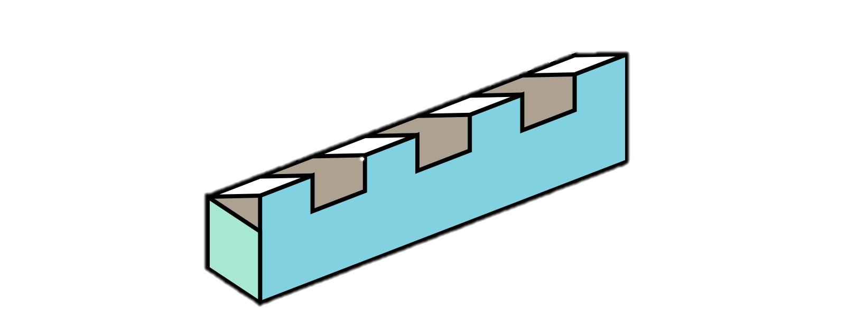
“Can you make design a housing layout on the model with different types of housing for different people?
You can add housing of different types with roads and gardens.”

Slide 20
“Did you manage to create enough homes to house 2,000 people?
What housing type seemed to work best or did you like to have a mix of different types?”
^{RIBA}
^{Learning_Mathematics Activity}

