Slide 1
RIBA International Case Studies
ABU DHABI, UAE

Slide 2
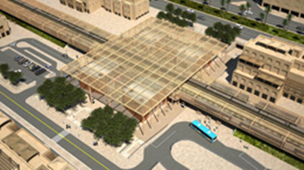
RIBA International Case Studies
Abu Dhabi
RIBA member John Harding, Principal Architect, International and Major Projects at Parsons Brinckerhoff Ltd, shares his experience of working overseas.
John's first overseas appointment was in Singapore in 1996, and since then he has worked in Taiwan and Malaysia. Most recently he has been involved in providing station concept designs for a proposed 1500km railway in Abu Dhabi.
John explains what motivated him to look for architectural work outside of the UK:
A large canopy shades the street
'I wanted to work on large, civic, urban and national scale projects and these were plentiful outside of the UK. Soon after becoming a Chartered Architect and completing a Masters in Urban Design in 1993 I headed eastwards towards the double-digit 'growth tiger' economies of South East Asia, where I lived and worked with my young family in Singapore, Malaysia and Taiwan from 1996 to 2007.

Slide 3
RIBA International Case Studies
Abu Dhabi
I now work for Parsons Brinckerhoff, a company benefitting from over 125 years operational experience in developed and emerging infrastructure markets and has established offices in many countries. Currently I travel to work in Abu Dhabi, Israel and Istanbul located within the EuMENA (Europe, Middle East and North Africa) region.
Global growth of infrastructure and urbanisation had driven my career in urban design and transport architecture since I first headed eastwards in 1996.'
John anticipates that opportunities overseas will continue for UK architects. He says:
'The RIBA's recent report, 'The Future for Architects?' reports that the increasing population, urbanisation and construction demand means the forecast to 2020 is for 128% growth in infrastructure in emerging markets, compared to 18% in developed markets. Of course, forecasts are forecasts, and we are in unknown territory, but a decrease or plateau in population and urbanisation within the next decade seems less likely. So perhaps optimistically, the trend of an ageing and decreasing population, seen in developed markets, may slowly advance in emerging markets over the next generations, as a consequence of increased urbanisation, better infrastructure, sustainable development, and prosperity in terms of economics, health and well-being. Modestly contributing to that long-term process of geographic, demographic and economic change is a motivating thrill when looking outside of the UK for work.'

Slide 4
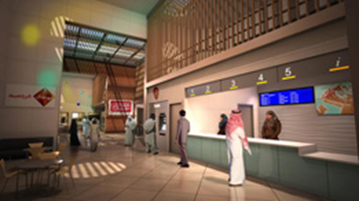
RIBA International Case Studies
Abu Dhabi
Double-height entrance pavilions around an enclosed, shaded pedestrian street
Having a local office in Abu Dhabi has really helped John and the team at Parsons Brinckerhoff, whether they are winning a contract via a public tender or handling legal issues, it is vital to have people 'on the ground' in the country you are working in. John also advises that you may need experienced assistance to deal with local regulations and standards.
John's key learnings
Observe, observe, observe 'Being away from home gave me time to visit other places within the UAE, spend time sight-seeing, take desert drives, and kayak in mangroves at the weekend. On those adventures I photographed, observed, and learned about the unique UAE built environment and came to understand how past, and present architects and builders responded in the way they did. UAE is a vast resource to be read. Observations and other research insights allowed discussion and agreement of a shared vision, and fundamental design objectives and creation of a framework to gain consensus from the client body. Then, having established a way to measure, qualify and assess the design, I produced an original concept which was responsive to clients’ concerns, vision and design objectives that suited Abu Dhabi’s climate, cultural and functional requirements.'

Slide 5
RIBA International Case Studies
Abu Dhabi
Be open 'I learned that it is important to be open with the client and take time to describe the steps taken during the design process. Be prepared to discuss and explain the design outcome and be prepared to change and modify following discussion. Produce a conceptual design report that includes discussions of different opinions and options. Demonstrate why one option is better than several. Consider all viewpoints and options then provide an overview and summary. Finally, draw concise evidence based conclusions and demonstrate how the design mirrors the vision.
This process allows a more balanced debate of both esoteric and fundamental issues, options and configurations and increased likelihood of client acceptance and payment.‘
John's top tips for working overseas
Maintain risks within your capacity to cope: payments may take longer, and deliverables may require more effort and resources, to incorporate client comments. You may require experienced assistance to deal with local regulations and standards. You may need deep pockets.
First things first: establish and agree a vision and agree the judging criteria for your work with the client.

Slide 6
RIBA International Case Studies
Abu Dhabi
Enjoy what you do and specialise: be prepared to spend some time in the country. Be open minded, lack prejudice, solve problems and create insights. Identify ways that other architects have dealt with cultural, climatic and built environmental issues. For example, explain the built environment’s morphological configuration, in terms of shade or interdependencies, and how that insight influences design objectives. You may be able to add value by your own perspective and insights and produce something original. Your proposal may the first, biggest, longest, highest, fastest, competitive, cleanest, healthiest, sustainable design yet proposed for this country. Therefore, nurture and create an interdependent relationship because the client needs you and your proposal, whilst you need your client.
Under promise and over perform: be responsive and listen. Look, feel and empathise with the client’s concerns. Be prepared to defend, or modify proposals according to client comments.

