Slide 1
RIBA International Case Studies
CHINA

Slide 2
RIBA International Case Studies
China
Yuxhou Shanghai © Haskoll
Peter Goldsmith is the Chairman at Haskoll, Beijing. Haskoll is an architectural design company in Beijing and London.
Peter says: 'When we took on our first project in Shanghai it was when things were busier in the UK. We just wanted to keep a flame alive, we were not quite sure where business in China would lead, to begin with.'
It was Peter's personal interest in China that led him to work there. He has an adopted daughter who is originally Chinese and this motivated him to explore the country. Peter began his exploration eight years ago when he went on a UKTI trade mission to China. He made some strong contacts during the trade mission and this opened doors for him and Haskoll. Initially the Haskoll team were working from London and out hotels in Beijing, but eight years on from that first project they now have over 40 people working in their Beijing office, almost mirroring the size of their UK office.

Slide 3
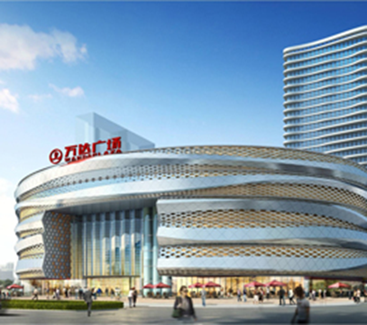
RIBA International Case Studies
China
Peter says: 'It's important to have an empathy to the culture. You will get knocks and there are negatives to overcome so you have to have a passion. When I interview people to move to China, it's important to get people who are going to fit, and who are going to laugh.'
A key project for Haskoll in China has been the conversion of a department store in Shanghai – it was on a modest scale but next door to a listed theatre from 1930s. The biggest challenge was that the developer had to get this finished in just six months before the Shanghai World Expo, including securing planning permission.
Wanda © Haskoll

Slide 4
RIBA International Case Studies
China
Peter says: 'It is quite a different process than the UK to get permission – it's political but not in the same way as in the UK. For example you may get to suggest who would be good to sit on the planning committee!.'
The information that is required when planning a project is quite different from what you experience in the UK. For example, you will need to consider very carefully the sun path analysis and a consideration of Feng shui is essential too. You can get consultants to advise on these things: I was advised to put a vase of water at a certain point in a building by a Feng shui expert.
Dates are important as well as design, such as when to move into a particular building can be crucial too.
The balance of nature is also important – for example, site position in relation to mountains and water.
To find clients, it is essential to have personal contacts in the country.
Peter says: 'This particular client we found through personal contacts in China – almost all business is done through some personal connection. You might need a person who acts as a 'bridge' and you may have to be introduced by someone who knows both parties.'
When it comes to legal issues it helps to have some very good legal advisors and remember that the contracts will be in Chinese not English.

Slide 5
RIBA International Case Studies
China
Peter says: 'Contracts are honoured in China but there is a readiness to change the contract or have a new contract if it helps the project or things change and this is not necessarily a bad thing. We have had to learn what are the right fee scales and with contracts we have had to learn too and are still developing this.'
Getting paid is different when working overseas and something worth thinking about upfront.
Peter says: 'Setting up a WOFE (Wholly owned foreign entity) helps when it comes to getting paid as the contract is between two Chinese entities. It is difficult to get paid in China and exporting fees is difficult too. Most local Chinese clients will only sign a contract which will be paid in local currency. I think when people go to China they may first go on the back of international companies and then they will be paid in the UK but that didn’t work for us – most our clients are Chinese. There still aren't that many international companies doing significant real estate developments in China.'

Slide 6
RIBA International Case Studies
China
As a result of working overseas, Haskoll has seen financial success:
Wenling © Haskoll
Peter says: 'In the last three to four years our office in Beijing has doubled its income every year and this last year we made about 20% profit. Our income is becoming a higher and higher percentage of our overall overseas business. By the end of this year we will have similar staff numbers in China as our London head office and the Directors over here (UK) say they will not be surprised if China exceeds London in staffs numbers. We try to bring the best of our Western culture and expertise from London and to help people to see things differently.

Slide 7
RIBA International Case Studies
China
As a brand, Haskoll architects is a global brand and what we are providing in China is more than helping with this overall design service. A number of clients and developers are looking to UK and so work flows both ways – the speed at which this is happening surprised me – it's invaluable to have that connection.'
TOP TIPS
Peter's top tips for UK architects thinking about working in China:
British design and the RIBA are held in great esteem in China so providing a ‘western’ service can be a selling point and is something some clients will be looking for.
Making contacts in the country you are working in and showing a passion for the country is vital. Having a team on the ground is important.
Be aware of and get advice on cultural issues, such as Feng shui and the Chinese way of doing business.
Speed of working and delivery of design is very fast.
China is still a developing country and economy and therefore methods and quality of construction and the overall cost base is very different.

